Slide 1
Instructions
Intended use
West Nile virus sign for print and outdoor use. Dimensions: 24 x 18 inches.
Branding
State and Local Health Departments may change design colors and add branding elements to align with any branding restrictions.
Exporting slides as a different file type
File > Save a Copy
Change “PowerPoint Presentation (*.pptx)” to whichever file type you prefer, such as .pdf, .jpg, .png, etc.
Save
Questions or requests
Contact CDC-INFO at 800-232-4636 or https://www.cdc.gov/cdc-info/index.html

Slide 2




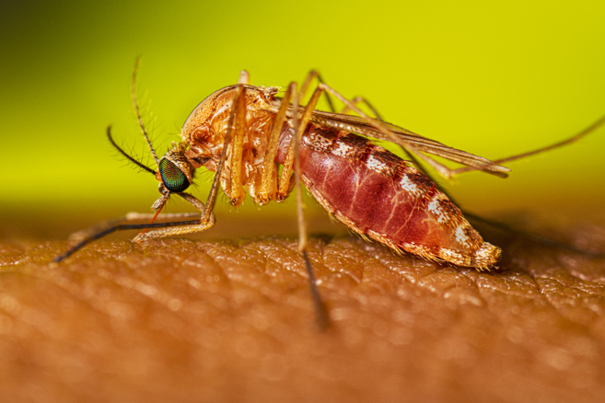
WEST NILE VIRUS HAS BEEN DETECTED IN THIS AREA
Don’t get sick from mosquito bites
Use EPA-registered mosquito repellent
Wear long, loose-fitting shirts and pants
Avoid being outside from dusk to dawn
Use screens on windows and doors or air conditioning

