Slide 1
Add Your Title
Note: Throughout this presentation, certain text is highlighted in purple. Please replace all purple-highlighted text with the recommended copy, then remove the purple highlighting. Once all highlights are removed and copy is final, delete this instruction box.
Add Your Name, Title, and Organization
Add the Date
Reference to specific commercial products, manufacturers, companies, or trademarks does not constitute its endorsement or recommendation by the U.S. Government, Department of Health and Human Services, or Centers for Disease Control and Prevention
Source: Centers for Disease Control and Prevention (CDC).

Slide 2
Sepsis Impacts the U.S. and Our Hospital
Hospitals that use more of the Sepsis Core Elements have:¹
Each year, about 1.7 million adults and more than 18,000 children in America develop sepsis.^{2,3}
At least 350,000 adults and more than 1,800 children who develop sepsis die during their hospitalization or are discharged to hospice.^{2,3}
Lower mortality among patients with sepsis
Improved sepsis management
Improved performance in quality measures, such as SEP-1
In 2018, the total cost of hospital stays and follow-up nursing care for all Medicare patients with sepsis (including fee-for-service and Medicare Advantage) reached $41.5 billion .⁴
Our Hospital
XX
admissions with sepsis each year
XX
principal diagnosis
$XX
total cost

Slide 3

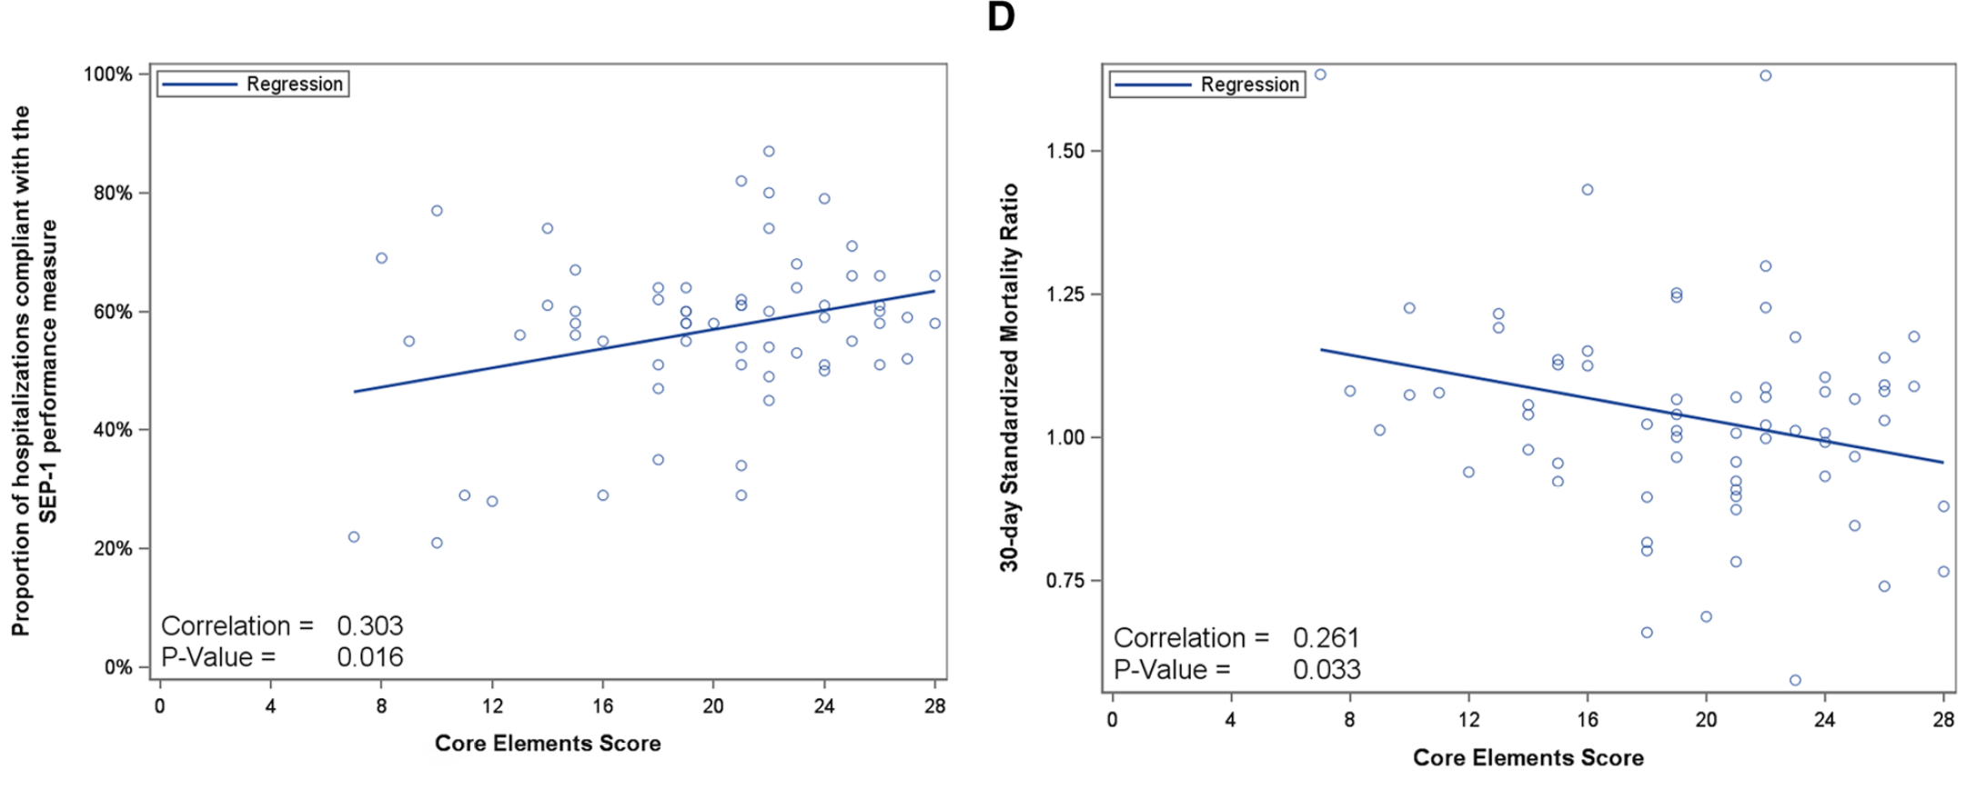
The Sepsis Core Elements Can Help Improve Sepsis Management and Outcomes¹
  Greater uptake of the core elements associated with better SEP-1 performance and lower mortality ratio.
Figure 1 Correlation of Core Elements score with sepsis management and outcomes.
C
D

Slide 4

We Must Act Fast – Option 1
We Must Act Fast
Option 1
The patients and families who are impacted by sepsis are more than just numbers.
XX [If you have one, share a personal or patient story about sepsis to help the issue come to life.]

Slide 5
What are the Sepsis Core Elements?
What it is
What it isn’t
A framework detailing “how to build a successful hospital sepsis program” to monitor and optimize hospital management and outcomes of sepsis
Not a clinical guideline for direct patient care
A complementary tool to existing sepsis guidelines to facilitate implementation of recommended practices for U.S. hospitals and hospital systems
Not limited or restricted to specific hospital types
and populations
A multidisciplinary approach that relies on leadership, information technology, social work, and more
Not just for clinical care staff

Slide 6
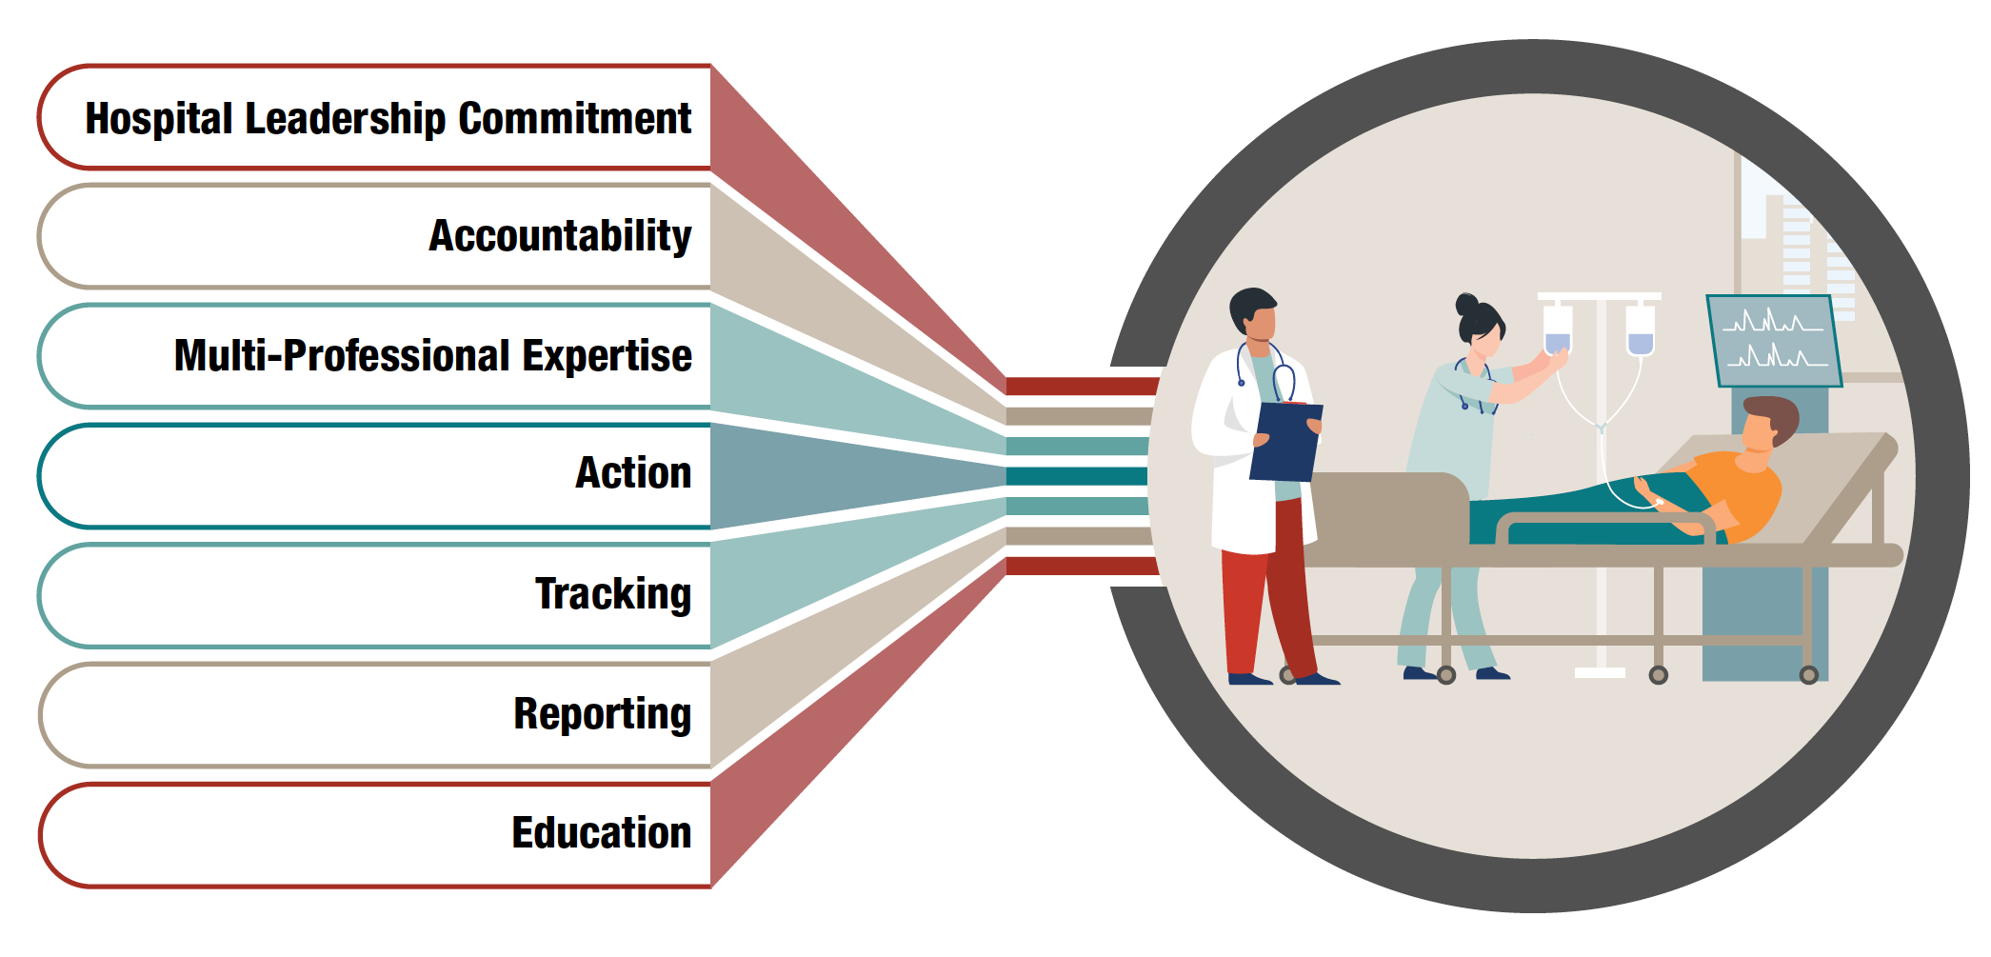
The 7 Sepsis Core Elements of a Successful Sepsis Program⁵

Slide 7
The Sepsis Core Elements Can Improve
Costs and Outcomes at Our Facility

Slide 8
Identifying Areas for Improvement Helps Us Realize Return On Investment
Opportunities for improvement:
XX [Add in needs analysis results and areas for improvement]
Example: Sepsis program leader(s) are not given sufficient specified time to manage the hospital sepsis program
  XX [Fill in the work you’ve completed to investigate hours needed for dedicated sepsis program work]
  Example: Identified and interviewed a quality manager and two infection control experts to gather their insights on our program’s gaps and opportunities.
Example: Sepsis program is not provided with sufficient resources, including data analytics and information technology support, to operate the program effectively
  Example: Evaluated whether current systems can support necessary data needs and future growth.
  Example: Gathered current IT performance information and identified gaps in technology, skills, or processes.
Current
Sepsis Core Elements
Score:
XX
out of 28
Potential return on investment if these areas are addressed:
  $XX cost savings [Add in high-level cost savings results from attached ROI Calculator for Improved SEP-1 performance based on decreased Length of Stay (LOS) Excel file]

Slide 9
Creating Our Hospital Sepsis Program

Slide 10
Our Sepsis Program Goals
The Sepsis Core Elements outline how hospitals can identify sepsis program goals
and track their metrics over time.⁵
Our proposed sepsis program goals:
  X
  Example: Decrease sepsis deaths by X% in the first year.
  Example: Reviewing sepsis cases weekly/monthly to identify barriers to timely recognition
  and treatment.
  Example: Implement X number of screening tools for early sepsis detection.

Slide 11
Our Sepsis Program Structure
Sepsis programs require multidisciplinary staff throughout the facility to support effective patient care. Such as:
  Antimicrobial stewardship
  Critical care
  Emergency medicine
  Hospital medicine
  Infectious diseases
  Nursing
  Other primary services (Example: surgery, oncology, obstetrics, pediatrics)
  Pharmacy
  Social work
We propose representation from:
  XX [Add overview of groups included in your proposed sepsis program and committee structure]

Slide 12

Leadership Commitment is Critical to Sepsis Program Success
We need you!
Your support is critical to our program’s success.
Ensure we can accomplish our goals—including ensuring we have human, financial, and information technology resources for success.
Help us raise awareness of and support for our sepsis program among hospital staff.

Slide 13
Resources
Sepsis Core Elements
Hospital Sepsis Program Assessment Tool
CDC Core Element training series (with Continuing Education credits)
Surviving Sepsis Guidelines 2026:
  Adults
  Children

Slide 14
Thank you!
Reference to specific commercial products, manufacturers, companies, or trademarks does not constitute its endorsement or recommendation by the U.S. Government, Department of Health and Human Services, or Centers for Disease Control and Prevention
Source: Centers for Disease Control and Prevention (CDC).

Slide 15
For More Information
For more information, please contact:
Centers for Disease Control and Prevention
Phone: 1-800-CDC-INFO (232-4636)
Web Form: www.cdc.gov/info
Web: www.cdc.gov/sepsis/core-elements.html
The findings and conclusions in this presentation are those
of the authors and do not necessarily represent the official position of the Centers for Disease Control and Prevention.
Reference to specific commercial products, manufacturers, companies, or trademarks does not constitute its endorsement or recommendation by the U.S. Government, Department of Health and Human Services, or Centers for Disease Control and Prevention
Source: Centers for Disease Control and Prevention (CDC).

Slide 16
References
Prescott, HC, Health M, Walzl E, McLaughlin E, Horowitz J, Jayaprakash N, Flanders SA, Dantes RB, Posa PJ; CDC’s Hospital Sepsis Program Core Elements are associated with improved management and outcomes of sepsis. American Journal of Respiratory and Critical Care Medicine. 2026 March 1; 212(3):537-541. doi: 10.1093/ajrccm/aamaf113. PMID: 41738107. PMCID: PMC13048602.
Rhee C, Dantes R, Epstein L, Murphy DJ, Seymour CW, Iwashyna TJ, Kadri SS, Angus DC, Danner RL, Fiore AE, Jernigan JA, Martin GS, Septimus E, Warren DK, Karcz A, Chan C, Menchaca JT, Wang R, Gruber S, Klompas M; CDC Prevention Epicenter Program. Incidence and Trends of Sepsis in US Hospitals Using Clinical vs Claims Data, 2009-2014. JAMA. 2017 Oct 3;318(13):1241-1249. doi: 10.1001/jama.2017.13836. PMID: 28903154; PMCID: PMC5710396.
Rhee C, Balamuth F, Dysart K, et al. National Estimates of Pediatric Sepsis in US Hospitals Using Clinical Data. JAMA. Published online March 22, 2026. doi:10.1001/jama.2026.3100.
Buchman TG, Simpson SQ, Sciarretta KL, Finne KP, Sowers N, Collier M, Chavan S, Oke I, Pennini ME, Santhosh A, Wax M, Woodbury R, Chu S, Merkeley TG, Disbrow GL, Bright RA, MaCurdy TE, Kelman JA. Sepsis Among Medicare Beneficiaries: 1. The Burdens of Sepsis, 2012-2018. Crit Care Med. 2020 Mar;48(3):276-288. doi: 10.1097/CCM.0000000000004224. PMID: 32058366; PMCID: PMC7017943.
Hospital Sepsis Program Core Elements: 2023.

