Slide 1

Prevalence of Obesity Based on Self-Reported Weight and Height Among US Adults by Age, State and Territory, BRFSS, 2025
Definitions
Obesity: Body mass index (BMI) of 30 kg/m² or higher.
Body mass index (BMI): A calculated measure of weight relative to height, defined as body weight in kilograms divided by height in meters squared.

Slide 2

Prevalence of Obesity Based on Self-Reported Weight and Height Among US Adults by Age, State and Territory, BRFSS, 2025
Method
The data were collected through the Behavioral Risk Factor Surveillance System (BRFSS), an ongoing, state-based, telephone interview survey conducted by state health departments with assistance from CDC.
Height and weight data used in the BMI calculations were self-reported.

Slide 3
Prevalence of Obesity Based on Self-Reported Weight and Height Among US Adults by Age, State and Territory,
BRFSS, 2025
Exclusion Criteria
Records with the following were excluded:
Height: <3 feet or ≥8 feet
Weight: <50 pounds or ≥650 pounds
BMI: <12 kg/m² or ≥100 kg/m²
Pregnant women

Slide 4
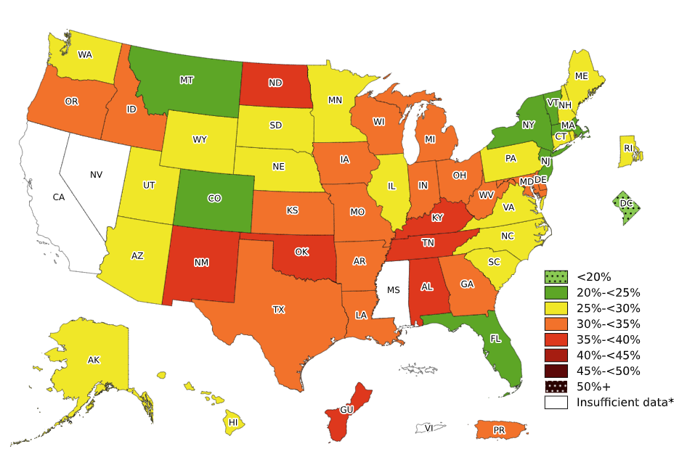
Prevalence of Obesity Based on Self-Reported Weight and Height Among Adults Aged 18–39 Years, by State and Territory, BRFSS, 2025
*Sample size <50, the relative standard error (dividing the standard error by the prevalence) ≥30%, or no data in a specific year.

Slide 5
Prevalence of Obesity Based on Self-Reported Weight and Height Among Adults Aged 18–39 Years, by State and Territory, BRFSS, 2025
State | Prevalence | 95% Confidence Interval
Alabama | 38.1 | (34.4, 42.0)
Alaska | 29.9 | (26.5, 33.4)
Arizona | 29.6 | (25.6, 33.9)
Arkansas | 32.8 | (29.4, 36.5)
California | Insufficient data* | Insufficient data*
Colorado | 21.1 | (19.3, 22.9)
Connecticut | 27.8 | (25.2, 30.6)
Delaware | 33.4 | (28.8, 38.3)
District of Columbia | 17.7 | (14.6, 21.3)
Florida | 24.6 | (21.8, 27.6)
Georgia | 30.2 | (27.3, 33.3)
Guam | 35.7 | (28.5, 43.5)
Hawaii | 28.9 | (26.2, 31.8)
Idaho | 30.5 | (27.0, 34.3)
Illinois | 28.2 | (26.2, 30.2)
Indiana | 32.9 | (29.7, 36.4)
Iowa | 30.4 | (28.2, 32.8)
Kansas | 34.1 | (31.8, 36.5)
Kentucky | 35.3 | (32.1, 38.6)
Louisiana | 30.0 | (26.9, 33.4)
Maine | 29.2 | (26.6, 32.0)
Maryland | 30.2 | (27.8, 32.8)
Massachusetts | 23.2 | (21.1, 25.4)
Michigan | 30.6 | (28.1, 33.2)
Minnesota | 28.8 | (26.8, 30.9)
Mississippi | Insufficient data* | Insufficient data*
Missouri | 33.4 | (30.4, 36.5)
State | Prevalence | 95% Confidence Interval
Montana | 22.8 | (20.2, 25.6)
Nebraska | 29.3 | (26.6, 32.3)
Nevada | Insufficient data* | Insufficient data*
New Hampshire | 27.3 | (23.1, 32.1)
New Jersey | 23.7 | (20.9, 26.7)
New Mexico | 37.3 | (32.7, 42.1)
New York | 24.5 | (23.0, 26.2)
North Carolina | 27.8 | (24.4, 31.5)
North Dakota | 35.6 | (32.4, 39.0)
Ohio | 32.1 | (29.2, 35.2)
Oklahoma | 36.7 | (33.3, 40.2)
Oregon | 30.7 | (27.7, 33.9)
Pennsylvania | 27.8 | (23.5, 32.5)
Puerto Rico | 32.1 | (28.0, 36.4)
Rhode Island | 28.7 | (25.5, 32.1)
South Carolina | 29.6 | (24.1, 35.8)
South Dakota | 26.0 | (21.5, 31.0)
Tennessee | 35.6 | (32.5, 38.7)
Texas | 32.2 | (29.3, 35.2)
Utah | 25.2 | (23.4, 27.2)
Vermont | 24.4 | (21.4, 27.7)
Virgin Islands | Insufficient data* | Insufficient data*
Virginia | 29.8 | (26.2, 33.5)
Washington | 27.4 | (25.9, 29.0)
West Virginia | 32.3 | (28.7, 36.0)
Wisconsin | 31.3 | (28.7, 34.0)
Wyoming | 29.9 | (26.2, 33.8)
*Sample size <50, the relative standard error (dividing the standard error by the prevalence) ≥30%, or no data in a specific year.
Source: Behavioral Risk Factor Surveillance System, CDC.

Slide 6
Prevalence of Obesity Based on Self-Reported Weight and Height Among Adults Aged 18–39 Years, by State and Territory, BRFSS, 2025
Summary
The District of Columbia had a prevalence of obesity less than 20%.
7 states had a prevalence of obesity between 20% and <25%.
18 states had a prevalence of obesity between 25% and <30%.
16 states and Puerto Rico had a prevalence of obesity between 30% and <35%.
6 states and Guam had a prevalence of obesity between 35% and <40%.
No state or territory with available data had a prevalence of obesity 40% or greater.

Slide 7
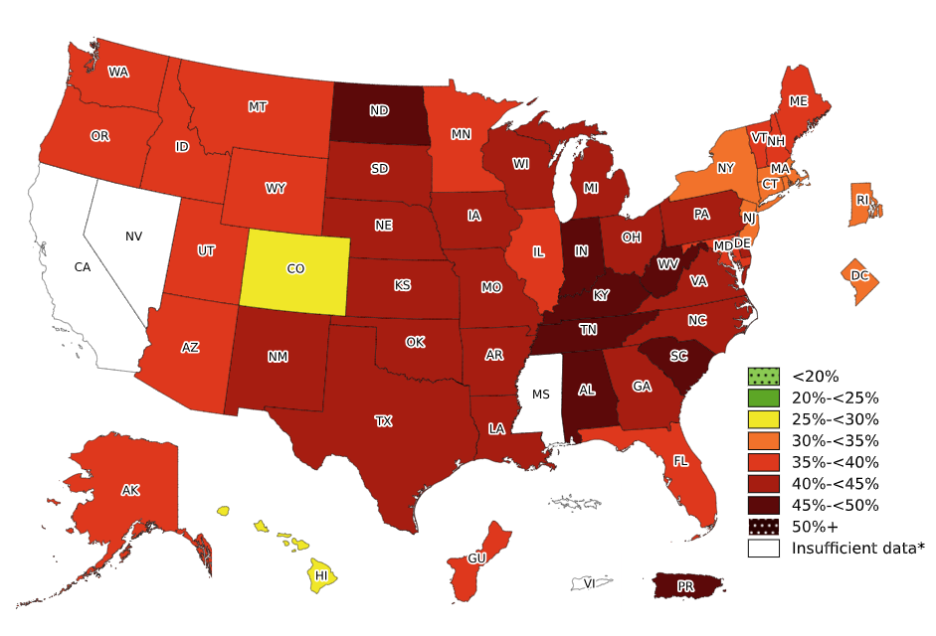
Prevalence of Obesity Based on Self-Reported Weight and Height Among Adults Aged 40–59 Years, by State and Territory, BRFSS, 2025
*Sample size <50, the relative standard error (dividing the standard error by the prevalence) ≥30%, or no data in a specific year.

Slide 8
Prevalence of Obesity Based on Self-Reported Weight and Height Among Adults Aged 40–59 Years, by State and Territory, BRFSS, 2025
State | Prevalence | 95% Confidence Interval
Alabama | 46.2 | (42.6, 49.8)
Alaska | 37.9 | (34.7, 41.3)
Arizona | 36.6 | (32.5, 41.0)
Arkansas | 44.3 | (40.9, 47.7)
California | Insufficient data* | Insufficient data*
Colorado | 29.5 | (27.5, 31.5)
Connecticut | 34.9 | (32.3, 37.6)
Delaware | 42.9 | (38.9, 47.1)
District of Columbia | 31.1 | (26.7, 35.9)
Florida | 38.3 | (35.0, 41.7)
Georgia | 44.4 | (41.2, 47.7)
Guam | 39.0 | (30.1, 48.6)
Hawaii | 29.9 | (27.2, 32.6)
Idaho | 36.8 | (33.0, 40.8)
Illinois | 39.4 | (37.3, 41.5)
Indiana | 47.3 | (44.1, 50.6)
Iowa | 44.6 | (42.3, 46.9)
Kansas | 43.2 | (40.7, 45.7)
Kentucky | 46.0 | (42.9, 49.1)
Louisiana | 43.4 | (40.2, 46.6)
Maine | 38.1 | (35.9, 40.4)
Maryland | 38.4 | (36.2, 40.6)
Massachusetts | 32.3 | (30.0, 34.7)
Michigan | 41.0 | (38.6, 43.5)
Minnesota | 38.5 | (36.7, 40.4)
Mississippi | Insufficient data* | Insufficient data*
Missouri | 42.6 | (39.2, 46.0)
State | Prevalence | 95% Confidence Interval
Montana | 37.0 | (34.1, 40.0)
Nebraska | 43.3 | (40.2, 46.4)
Nevada | Insufficient data* | Insufficient data*
New Hampshire | 38.9 | (35.2, 42.7)
New Jersey | 31.7 | (28.7, 34.7)
New Mexico | 40.3 | (36.2, 44.5)
New York | 33.8 | (31.9, 35.7)
North Carolina | 40.9 | (37.2, 44.7)
North Dakota | 47.6 | (44.5, 50.8)
Ohio | 41.4 | (38.5, 44.3)
Oklahoma | 41.5 | (38.4, 44.8)
Oregon | 36.1 | (33.2, 39.1)
Pennsylvania | 40.8 | (36.4, 45.2)
Puerto Rico | 45.7 | (41.9, 49.5)
Rhode Island | 33.4 | (30.4, 36.5)
South Carolina | 46.9 | (41.5, 52.4)
South Dakota | 43.9 | (38.9, 49.1)
Tennessee | 46.0 | (42.7, 49.4)
Texas | 43.6 | (40.1, 47.2)
Utah | 36.4 | (34.3, 38.5)
Vermont | 35.5 | (32.8, 38.3)
Virgin Islands | Insufficient data* | Insufficient data*
Virginia | 40.1 | (36.4, 44.0)
Washington | 36.2 | (34.6, 37.8)
West Virginia | 45.3 | (41.9, 48.7)
Wisconsin | 42.9 | (40.5, 45.3)
Wyoming | 36.8 | (33.5, 40.3)
*Sample size <50, the relative standard error (dividing the standard error by the prevalence) ≥30%, or no data in a specific year.
Source: Behavioral Risk Factor Surveillance System, CDC.

Slide 9
Prevalence of Obesity Based on Self-Reported Weight and Height Among Adults Aged 40–59 Years, by State and Territory, BRFSS, 2025
Summary
No state or territory with available data had a prevalence of obesity less than 25%.
Colorado and Hawaii had a prevalence of obesity between 25% and <30%.
5 states and the District of Columbia had a prevalence of obesity between 30% and <35%.
15 states and Guam had a prevalence of obesity between 35% and <40%.
18 states had a prevalence of obesity between 40% and <45%.
7 states and Puerto Rico had a prevalence of obesity between 45% and <50%.​

Slide 10
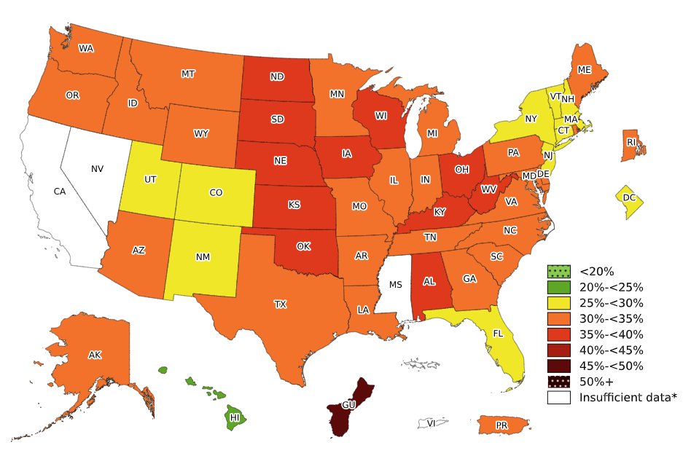
Prevalence of Obesity Based on Self-Reported Weight and Height Among Adults Aged 60 Years and Older, by State and Territory, BRFSS, 2025
*Sample size <50, the relative standard error (dividing the standard error by the prevalence) ≥30%,
or no data in a specific year.

Slide 11
Prevalence of Obesity Based on Self-Reported Weight and Height Among Adults Aged 60 Years and Older, by State and Territory, BRFSS, 2025
State | Prevalence | 95% Confidence Interval
Alabama | 35.4 | (32.6, 38.2)
Alaska | 31.7 | (29.0, 34.5)
Arizona | 31.3 | (28.5, 34.2)
Arkansas | 34.2 | (32.0, 36.5)
California | Insufficient data* | Insufficient data*
Colorado | 27.4 | (25.7, 29.2)
Connecticut | 28.9 | (26.8, 31.2)
Delaware | 33.6 | (31.1, 36.3)
District of Columbia | 27.8 | (24.2, 31.7)
Florida | 27.8 | (25.8, 30.0)
Georgia | 34.6 | (32.0, 37.2)
Guam | 45.8 | (23.0, 70.5)
Hawaii | 21.2 | (19.4, 23.0)
Idaho | 30.8 | (27.7, 34.0)
Illinois | 34.0 | (32.2, 35.9)
Indiana | 33.4 | (31.2, 35.8)
Iowa | 37.0 | (35.1, 38.8)
Kansas | 35.5 | (33.7, 37.4)
Kentucky | 36.0 | (33.6, 38.4)
Louisiana | 34.4 | (32.0, 36.8)
Maine | 32.0 | (30.5, 33.6)
Maryland | 30.9 | (29.3, 32.5)
Massachusetts | 26.6 | (24.8, 28.4)
Michigan | 34.7 | (33.0, 36.4)
Minnesota | 32.5 | (31.1, 33.9)
Mississippi | Insufficient data* | Insufficient data*
Missouri | 34.7 | (32.1, 37.4)
State | Prevalence | 95% Confidence Interval
Montana | 31.9 | (29.9, 34.1)
Nebraska | 37.1 | (34.7, 39.6)
Nevada | Insufficient data* | Insufficient data*
New Hampshire | 29.4 | (27.4, 31.4)
New Jersey | 26.0 | (23.5, 28.6)
New Mexico | 28.6 | (25.5, 32.0)
New York | 28.1 | (26.5, 29.8)
North Carolina | 33.1 | (30.1, 36.1)
North Dakota | 35.5 | (33.3, 37.7)
Ohio | 35.1 | (33.1, 37.2)
Oklahoma | 36.2 | (33.6, 38.8)
Oregon | 31.5 | (29.2, 34.0)
Pennsylvania | 32.9 | (29.3, 36.7)
Puerto Rico | 31.0 | (25.7, 36.7)
Rhode Island | 32.1 | (29.7, 34.7)
South Carolina | 34.2 | (30.6, 38.0)
South Dakota | 35.0 | (31.6, 38.5)
Tennessee | 32.7 | (30.1, 35.5)
Texas | 33.0 | (30.1, 36.2)
Utah | 29.2 | (27.4, 31.1)
Vermont | 28.2 | (26.2, 30.3)
Virgin Islands | Insufficient data* | Insufficient data*
Virginia | 33.7 | (30.6, 36.9)
Washington | 30.0 | (28.7, 31.4)
West Virginia | 36.0 | (33.7, 38.3)
Wisconsin | 36.3 | (34.7, 38.0)
Wyoming | 31.6 | (29.5, 33.8)
*Sample size <50, the relative standard error (dividing the standard error by the prevalence) ≥30%, or no data in a specific year.
Source: Behavioral Risk Factor Surveillance System, CDC.

Slide 12
Prevalence of Obesity Based on Self-Reported Weight and Height Among Adults Aged 60 Years and Older, by State and Territory, BRFSS, 2025
Summary
No state or territory with available data had a prevalence of obesity less than 20%.
One state (Hawaii) had a prevalence of obesity between 20% and <25%.
10 states and the District of Columbia had a prevalence of obesity between 25% and <30%.
25 states and Puerto Rico had a prevalence of obesity between 30% and <35%.
11 states had a prevalence of obesity between 35% and <40%.
One territory (Guam) had a prevalence of obesity 40% or greater.

