Slide 1

Prevalence of Obesity Based on Self-Reported Weight and Height Among US Adults by Race/Ethnicity, State and Territory,
BRFSS, 2023–2025
Definitions
Obesity: Body mass index (BMI) of 30 kg/m² or higher.
Body mass index (BMI): A calculated measure of weight relative to height, defined as body weight in kilograms divided by height in meters squared.

Slide 2
Prevalence of Obesity Based on Self-Reported Weight and Height Among US Adults by Race/Ethnicity, State and Territory,
BRFSS, 2023–2025
Method
The data were collected through the Behavioral Risk Factor Surveillance System (BRFSS), an ongoing, state-based, telephone interview survey conducted by state health departments with assistance from CDC.
Height and weight data used in the BMI calculations were self-reported.
Three years of data were combined to ensure sufficient sample size.

Slide 3
Prevalence of Obesity Based on Self-Reported Weight and Height Among US Adults by Race/Ethnicity, State and Territory,
BRFSS, 2023–2025
Exclusion Criteria
Records with the following were excluded:
Height: <3 feet or ≥8 feet
Weight: <50 pounds or ≥650 pounds
BMI: <12 kg/m² or ≥100 kg/m²
Pregnant women

Slide 4
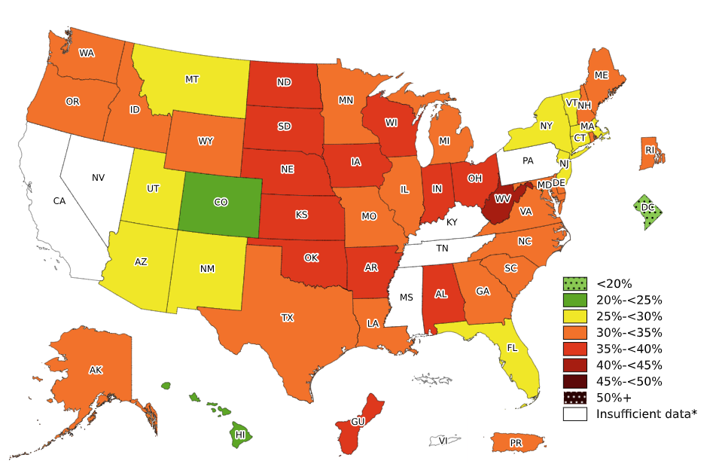
Prevalence of Obesity Based on Self-Reported Weight and Height Among Non-Hispanic White Adults, by State and Territory, BRFSS, 2023–2025
*Sample size <50, the relative standard error (dividing the standard error by the prevalence) ≥30%, or no data in a specific year.

Slide 5
Prevalence of Obesity Based on Self-Reported Weight and Height Among Non-Hispanic White Adults, by State and Territory, BRFSS, 2023–2025
State | Prevalence | 95% Confidence Interval
Alabama | 36.1 | (34.8, 37.5)
Alaska | 32.9 | (31.6, 34.2)
Arizona | 28.2 | (27.0, 29.4)
Arkansas | 37.1 | (36.0, 38.2)
California | Insufficient data* | Insufficient data*
Colorado | 23.6 | (22.9, 24.3)
Connecticut | 28.7 | (27.7, 29.8)
Delaware | 34.9 | (33.4, 36.4)
District of Columbia | 14.3 | (13.0, 15.8)
Florida | 29.1 | (28.1, 30.1)
Georgia | 32.6 | (31.4, 33.8)
Guam | 36.2 | (28.2, 45.1)
Hawaii | 20.3 | (18.9, 21.7)
Idaho | 31.2 | (30.1, 32.3)
Illinois | 34.0 | (33.0, 35.1)
Indiana | 37.6 | (36.7, 38.5)
Iowa | 37.0 | (36.2, 37.8)
Kansas | 36.3 | (35.5, 37.1)
Kentucky | Insufficient data* | Insufficient data*
Louisiana | 34.6 | (33.4, 35.8)
Maine | 33.3 | (32.6, 34.1)
Maryland | 30.7 | (29.9, 31.6)
Massachusetts | 26.4 | (25.6, 27.3)
Michigan | 34.9 | (34.1, 35.8)
Minnesota | 33.1 | (32.5, 33.8)
Mississippi | Insufficient data* | Insufficient data*
Missouri | 34.8 | (33.7, 35.8)
State | Prevalence | 95% Confidence Interval
Montana | 29.7 | (28.8, 30.6)
Nebraska | 37.0 | (36.1, 37.9)
Nevada | Insufficient data* | Insufficient data*
New Hampshire | 32.4 | (31.3, 33.5)
New Jersey | 26.4 | (25.3, 27.5)
New Mexico | 28.7 | (26.9, 30.6)
New York | 28.2 | (27.5, 28.9)
North Carolina | 31.5 | (30.1, 32.9)
North Dakota | 36.6 | (35.6, 37.6)
Ohio | 36.2 | (35.3, 37.0)
Oklahoma | 37.2 | (36.2, 38.3)
Oregon | 33.0 | (32.0, 34.0)
Pennsylvania | Insufficient data* | Insufficient data*
Puerto Rico | 32.0 | (17.6, 51.0)
Rhode Island | 30.0 | (28.9, 31.2)
South Carolina | 32.1 | (30.7, 33.5)
South Dakota | 35.9 | (34.0, 37.8)
Tennessee | Insufficient data* | Insufficient data*
Texas | 33.5 | (32.2, 34.9)
Utah | 29.3 | (28.6, 30.0)
Vermont | 29.2 | (28.2, 30.1)
Virgin Islands | Insufficient data* | Insufficient data*
Virginia | 32.6 | (31.4, 33.8)
Washington | 31.6 | (31.1, 32.2)
West Virginia | 40.5 | (39.5, 41.6)
Wisconsin | 36.9 | (36.1, 37.7)
Wyoming | 32.3 | (31.2, 33.4)
*Sample size <50, the relative standard error (dividing the standard error by the prevalence) ≥30%, or no data in a specific year.
Source: Behavioral Risk Factor Surveillance System, CDC.

Slide 6
Prevalence of Obesity Based on Self-Reported Weight and Height Among Non-Hispanic White Adults, by State and Territory, BRFSS, 2023–2025
Summary
One jurisdiction (District of Columbia) had a prevalence of obesity less than 20%.
Colorado and Hawaii had a prevalence of obesity between 20% and <25%.
10 states had a prevalence of obesity between 25% and <30%.
20 states and Puerto Rico had a prevalence of obesity between 30% and <35%.
11 states and Guam had a prevalence of obesity between 35% and <40%.
One state (West Virginia) had a prevalence of obesity 40% or greater.

Slide 7
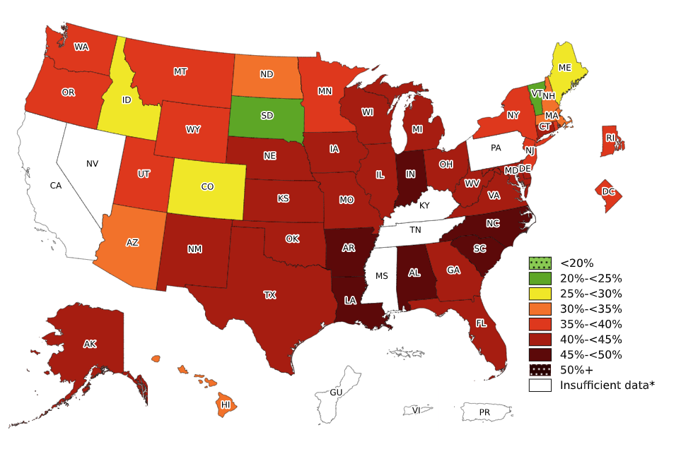
Prevalence of Obesity Based on Self-Reported Weight and Height Among Non-Hispanic Black Adults, by State and Territory, BRFSS, 2023–2025
*Sample size <50, the relative standard error (dividing the standard error by the prevalence) ≥30%, or no data in a specific year.

Slide 8
Prevalence of Obesity Based on Self-Reported Weight and Height Among Non-Hispanic Black Adults, by State and Territory, BRFSS, 2023–2025
State | Prevalence | 95% Confidence Interval
Alabama | 49.2 | (47.0, 51.5)
Alaska | 42.7 | (35.5, 50.2)
Arizona | 34.3 | (28.8, 40.3)
Arkansas | 46.2 | (42.9, 49.5)
California | Insufficient data* | Insufficient data*
Colorado | 29.3 | (25.7, 33.1)
Connecticut | 41.3 | (38.1, 44.5)
Delaware | 44.9 | (41.6, 48.2)
District of Columbia | 37.3 | (34.9, 39.7)
Florida | 40.1 | (36.9, 43.3)
Georgia | 43.0 | (41.0, 45.0)
Guam | Insufficient data* | Insufficient data*
Hawaii | 34.0 | (26.5, 42.4)
Idaho | 25.1 | (14.2, 40.6)
Illinois | 42.8 | (40.3, 45.3)
Indiana | 45.2 | (42.1, 48.2)
Iowa | 41.8 | (37.0, 46.6)
Kansas | 43.2 | (39.3, 47.2)
Kentucky | Insufficient data* | Insufficient data*
Louisiana | 46.6 | (44.4, 48.8)
Maine | 29.9 | (23.2, 37.5)
Maryland | 40.9 | (39.4, 42.4)
Massachusetts | 34.7 | (31.5, 38.0)
Michigan | 44.0 | (41.4, 46.5)
Minnesota | 35.2 | (32.4, 38.2)
Mississippi | Insufficient data* | Insufficient data*
Missouri | 43.8 | (40.7, 47.0)
State | Prevalence | 95% Confidence Interval
Montana | 37.2 | (22.9, 54.2)
Nebraska | 40.3 | (35.9, 44.9)
Nevada | Insufficient data* | Insufficient data*
New Hampshire | 31.3 | (20.1, 45.3)
New Jersey | 37.6 | (34.9, 40.3)
New Mexico | 42.0 | (31.4, 53.5)
New York | 36.0 | (34.4, 37.7)
North Carolina | 46.0 | (43.1, 48.9)
North Dakota | 30.1 | (23.7, 37.3)
Ohio | 41.5 | (38.5, 44.7)
Oklahoma | 44.7 | (40.7, 48.8)
Oregon | 38.0 | (30.2, 46.4)
Pennsylvania | Insufficient data* | Insufficient data*
Puerto Rico | Insufficient data* | Insufficient data*
Rhode Island | 36.0 | (31.1, 41.1)
South Carolina | 47.5 | (44.4, 50.6)
South Dakota | 20.3 | (11.0, 34.5)
Tennessee | Insufficient data* | Insufficient data*
Texas | 43.7 | (40.3, 47.0)
Utah | 37.4 | (29.9, 45.6)
Vermont | 23.6 | (16.5, 32.5)
Virgin Islands | Insufficient data* | Insufficient data*
Virginia | 44.4 | (41.7, 47.1)
Washington | 37.5 | (34.7, 40.3)
West Virginia | 41.5 | (34.9, 48.4)
Wisconsin | 44.1 | (40.8, 47.5)
Wyoming | 38.2 | (23.9, 54.9)
*Sample size <50, the relative standard error (dividing the standard error by the prevalence) ≥30%, or no data in a specific year.
Source: Behavioral Risk Factor Surveillance System, CDC.

Slide 9
Prevalence of Obesity Based on Self-Reported Weight and Height Among Non-Hispanic Black Adults, by State and Territory, BRFSS, 2023–2025
Summary
Vermont and South Dakota had a prevalence of obesity less than 25%.
3 states had a prevalence of obesity between 25% and <30%.
5 states had a prevalence of obesity between 30% and <35%.
9 states and the District of Columbia had a prevalence of obesity between 35% and <40%.
19 states had a prevalence of obesity between 40% and <45%.
6 states had a prevalence of obesity between 45% and <50%.
No state or territory with available data had a prevalence of obesity 50% or greater.

Slide 10
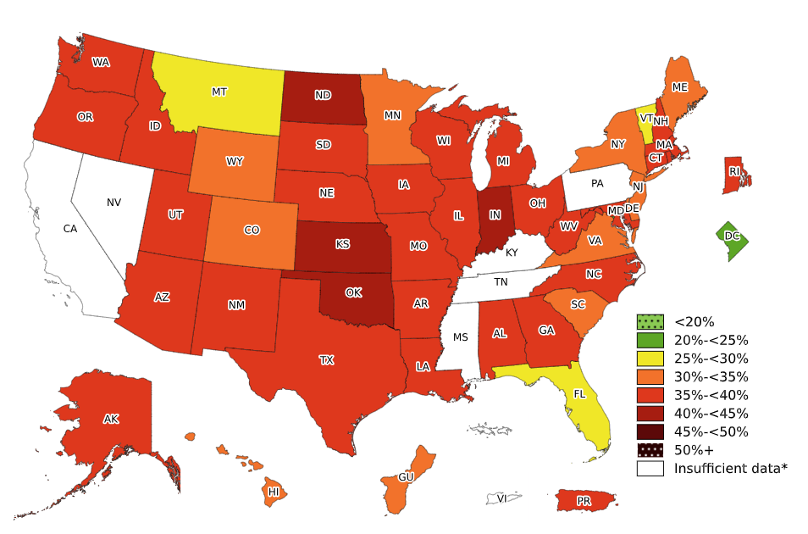
Prevalence of Obesity Based on Self-Reported Weight and Height Among Hispanic Adults, by State and Territory, BRFSS, 2023–2025
*Sample size <50, the relative standard error (dividing the standard error by the prevalence) ≥30%,
or no data in a specific year.

Slide 11
Prevalence of Obesity Based on Self-Reported Weight and Height Among Hispanic Adults, by State and Territory, BRFSS, 2023–2025
State | Prevalence | 95% Confidence Interval
Alabama | 35.4 | (28.9, 42.6)
Alaska | 38.8 | (33.7, 44.1)
Arizona | 39.7 | (37.2, 42.2)
Arkansas | 38.7 | (33.8, 43.8)
California | Insufficient data* | Insufficient data*
Colorado | 31.7 | (30.1, 33.4)
Connecticut | 36.3 | (33.9, 38.7)
Delaware | 33.1 | (28.9, 37.5)
District of Columbia | 24.3 | (20.1, 29.0)
Florida | 28.5 | (26.2, 30.9)
Georgia | 37.7 | (34.0, 41.6)
Guam | 34.6 | (23.8, 47.2)
Hawaii | 34.3 | (31.4, 37.5)
Idaho | 37.5 | (33.9, 41.3)
Illinois | 37.9 | (36.0, 39.9)
Indiana | 40.4 | (37.3, 43.6)
Iowa | 39.2 | (36.3, 42.1)
Kansas | 40.9 | (38.0, 43.9)
Kentucky | Insufficient data* | Insufficient data*
Louisiana | 38.9 | (33.9, 44.2)
Maine | 31.4 | (26.1, 37.2)
Maryland | 37.6 | (35.2, 40.1)
Massachusetts | 37.0 | (34.8, 39.4)
Michigan | 37.2 | (33.1, 41.5)
Minnesota | 34.0 | (31.4, 36.8)
Mississippi | Insufficient data* | Insufficient data*
Missouri | 36.8 | (31.9, 42.0)
State | Prevalence | 95% Confidence Interval
Montana | 29.6 | (24.9, 34.9)
Nebraska | 37.5 | (35.2, 39.8)
Nevada | Insufficient data* | Insufficient data*
New Hampshire | 35.7 | (28.7, 43.4)
New Jersey | 33.7 | (31.7, 35.8)
New Mexico | 39.8 | (37.5, 42.3)
New York | 33.8 | (32.5, 35.1)
North Carolina | 36.0 | (32.7, 39.4)
North Dakota | 40.0 | (34.0, 46.3)
Ohio | 37.3 | (32.0, 42.8)
Oklahoma | 41.0 | (37.8, 44.3)
Oregon | 39.2 | (36.1, 42.3)
Pennsylvania | Insufficient data* | Insufficient data*
Puerto Rico | 36.0 | (34.6, 37.3)
Rhode Island | 37.7 | (34.7, 40.7)
South Carolina | 32.8 | (27.9, 38.0)
South Dakota | 37.8 | (29.2, 47.2)
Tennessee | Insufficient data* | Insufficient data*
Texas | 38.4 | (36.5, 40.3)
Utah | 35.5 | (33.5, 37.5)
Vermont | 29.9 | (24.1, 36.4)
Virgin Islands | Insufficient data* | Insufficient data*
Virginia | 32.2 | (28.1, 36.6)
Washington | 36.7 | (35.2, 38.1)
West Virginia | 35.5 | (27.4, 44.4)
Wisconsin | 35.2 | (32.4, 38.1)
Wyoming | 32.7 | (28.7, 37.0)
*Sample size <50, the relative standard error (dividing the standard error by the prevalence) ≥30%, or no data in a specific year.
Source: Behavioral Risk Factor Surveillance System, CDC.

Slide 12
Prevalence of Obesity Based on Self-Reported Weight and Height Among Hispanic Adults, by State and Territory, BRFSS, 2023–2025
Summary
One jurisdiction (District of Columbia) had a prevalence of obesity less than 25%.
3 states had a prevalence of obesity between 25% and <30%.
10 states and Guam had a prevalence of obesity between 30% and <35%.
27 states and Puerto Rico had a prevalence of obesity between 35% and <40%.
4 states had a prevalence of obesity between 40% and <45%.
No state or territory with available data had a prevalence of obesity 45% or greater.

Slide 13
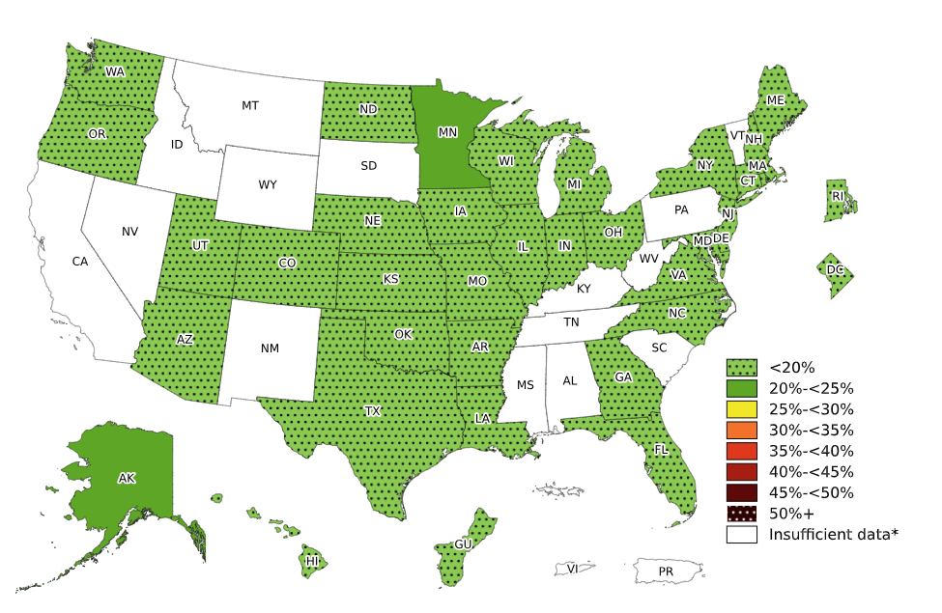
Prevalence of Obesity Based on Self-Reported Weight and Height Among Non-Hispanic Asian Adults, by State and Territory, BRFSS, 2023–2025
*Sample size <50, the relative standard error (dividing the standard error by the prevalence) ≥30%,
or no data in a specific year.

Slide 14
Prevalence of Obesity Based on Self-Reported Weight and Height Among Non-Hispanic Asian Adults, by State and Territory, BRFSS, 2023–2025
State | Prevalence | 95% Confidence Interval
Alabama | Insufficient data* | Insufficient data*
Alaska | 22.4 | (17.3, 28.4)
Arizona | 18.9 | (12.9, 26.8)
Arkansas | 13.9 | (8.2, 22.5)
California | Insufficient data* | Insufficient data*
Colorado | 11.2 | (8.5, 14.6)
Connecticut | 11.6 | (8.6, 15.5)
Delaware | 15.6 | (10.2, 23.0)
District of Columbia | 10.9 | (7.2, 16.3)
Florida | 12.8 | (8.5, 18.8)
Georgia | 12.3 | (8.6, 17.4)
Guam | 19.5 | (15.4, 24.6)
Hawaii | 18.0 | (16.7, 19.4)
Idaho | Insufficient data* | Insufficient data*
Illinois | 12.9 | (10.7, 15.5)
Indiana | 12.0 | (8.2, 17.3)
Iowa | 13.3 | (9.3, 18.5)
Kansas | 16.1 | (12.0, 21.3)
Kentucky | Insufficient data* | Insufficient data*
Louisiana | 13.9 | (8.3, 22.2)
Maine | 13.2 | (7.6, 21.9)
Maryland | 12.4 | (10.2, 15.0)
Massachusetts | 12.2 | (9.9, 14.9)
Michigan | 16.7 | (12.5, 22.1)
Minnesota | 20.6 | (17.4, 24.2)
Mississippi | Insufficient data* | Insufficient data*
Missouri | 15.7 | (10.6, 22.6)
State | Prevalence | 95% Confidence Interval
Montana | Insufficient data* | Insufficient data*
Nebraska | 15.9 | (11.0, 22.3)
Nevada | Insufficient data* | Insufficient data*
New Hampshire | 12.1 | (7.7, 18.4)
New Jersey | 13.6 | (11.1, 16.6)
New Mexico | Insufficient data* | Insufficient data*
New York | 14.0 | (12.2, 16.1)
North Carolina | 12.7 | (8.5, 18.4)
North Dakota | 17.5 | (10.5, 27.7)
Ohio | 15.1 | (10.8, 20.7)
Oklahoma | 13.2 | (9.0, 19.0)
Oregon | 17.0 | (12.7, 22.4)
Pennsylvania | Insufficient data* | Insufficient data*
Puerto Rico | Insufficient data* | Insufficient data*
Rhode Island | 15.3 | (10.5, 21.9)
South Carolina | Insufficient data* | Insufficient data*
South Dakota | Insufficient data* | Insufficient data*
Tennessee | Insufficient data* | Insufficient data*
Texas | 13.5 | (10.3, 17.6)
Utah | 13.7 | (10.2, 18.1)
Vermont | Insufficient data* | Insufficient data*
Virgin Islands | Insufficient data* | Insufficient data*
Virginia | 15.2 | (11.3, 20.2)
Washington | 13.7 | (12.4, 15.2)
West Virginia | Insufficient data* | Insufficient data*
Wisconsin | 15.8 | (11.9, 20.7)
Wyoming | Insufficient data* | Insufficient data*
*Sample size <50, the relative standard error (dividing the standard error by the prevalence) ≥30%, or no data in a specific year.
Source: Behavioral Risk Factor Surveillance System, CDC.

Slide 15
Prevalence of Obesity Based on Self-Reported Weight and Height Among Non-Hispanic Asian Adults, by State and Territory, BRFSS, 2023–2025
Summary
33 states, the District of Columbia, and Guam had a prevalence of obesity less than 20%.
Alaska and Minnesota had a prevalence of obesity between 20% and <25%.
No state or territory with available data had a prevalence of obesity 25% or greater

Slide 16
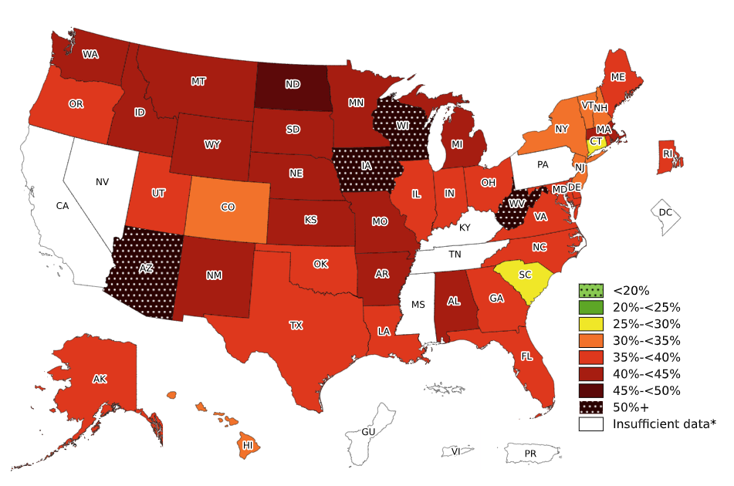
Prevalence of Obesity Based on Self-Reported Weight and Height Among Non-Hispanic American Indian or Alaska Native Adults, by State and Territory, BRFSS, 2023–2025
*Sample size <50, the relative standard error (dividing the standard error by the prevalence) ≥30%,
or no data in a specific year.

Slide 17
Prevalence of Obesity Based on Self-Reported Weight and Height Among Non-Hispanic American Indian or Alaska Native Adults, by State and Territory, BRFSS, 2023–2025
State | Prevalence | 95% Confidence Interval
Alabama | 44.2 | (32.2, 56.9)
Alaska | 38.5 | (35.4, 41.7)
Arizona | 50.8 | (45.4, 56.2)
Arkansas | 41.9 | (32.6, 51.9)
California | Insufficient data* | Insufficient data*
Colorado | 30.8 | (23.8, 38.7)
Connecticut | 29.7 | (18.0, 44.9)
Delaware | 39.1 | (23.6, 57.0)
District of Columbia | Insufficient data* | Insufficient data*
Florida | 36.4 | (26.6, 47.5)
Georgia | 37.0 | (22.2, 54.7)
Guam | Insufficient data* | Insufficient data*
Hawaii | 33.7 | (19.5, 51.7)
Idaho | 43.7 | (33.0, 55.0)
Illinois | 35.2 | (24.8, 47.2)
Indiana | 37.1 | (26.5, 49.1)
Iowa | 53.7 | (40.1, 66.7)
Kansas | 41.2 | (34.6, 48.0)
Kentucky | Insufficient data* | Insufficient data*
Louisiana | 36.7 | (28.1, 46.3)
Maine | 37.9 | (31.0, 45.4)
Maryland | 37.4 | (28.3, 47.5)
Massachusetts | 40.3 | (28.6, 53.3)
Michigan | 43.0 | (33.5, 53.1)
Minnesota | 43.9 | (37.8, 50.2)
Mississippi | Insufficient data* | Insufficient data*
Missouri | 40.4 | (30.8, 50.9)
State | Prevalence | 95% Confidence Interval
Montana | 42.9 | (39.0, 46.9)
Nebraska | 43.3 | (34.9, 52.1)
Nevada | Insufficient data* | Insufficient data*
New Hampshire | 33.7 | (20.0, 50.9)
New Jersey | 31.1 | (19.7, 45.4)
New Mexico | 41.3 | (36.0, 46.9)
New York | 34.6 | (26.7, 43.5)
North Carolina | 35.0 | (25.5, 45.8)
North Dakota | 49.9 | (44.2, 55.6)
Ohio | 38.1 | (26.3, 51.6)
Oklahoma | 38.9 | (35.6, 42.3)
Oregon | 37.9 | (29.2, 47.4)
Pennsylvania | Insufficient data* | Insufficient data*
Puerto Rico | Insufficient data* | Insufficient data*
Rhode Island | 39.9 | (26.4, 55.1)
South Carolina | 29.2 | (20.2, 40.2)
South Dakota | 42.8 | (36.4, 49.4)
Tennessee | Insufficient data* | Insufficient data*
Texas | 39.9 | (27.5, 53.8)
Utah | 38.5 | (31.5, 45.9)
Vermont | 32.0 | (21.9, 44.0)
Virgin Islands | Insufficient data* | Insufficient data*
Virginia | 38.0 | (27.3, 50.1)
Washington | 44.1 | (39.3, 48.9)
West Virginia | 51.6 | (38.1, 64.9)
Wisconsin | 53.1 | (45.7, 60.3)
Wyoming | 43.2 | (33.1, 53.9)
*Sample size <50, the relative standard error (dividing the standard error by the prevalence) ≥30%, or no data in a specific year.
Source: Behavioral Risk Factor Surveillance System, CDC.

Slide 18
Prevalence of Obesity Based on Self-Reported Weight and Height Among Non-Hispanic American Indian or Alaska Native Adults, by State and Territory, BRFSS, 2023–2025
Summary
No state or territory with available data had a prevalence of obesity less than 25%.
South Carolina and Connecticut had a prevalence of obesity between 25% and <30%.
6 states had a prevalence of obesity between 30% and <35%.
17 states had a prevalence of obesity between 35% and <40%.
14 states had a prevalence of obesity between 40% and <45%.
One state (North Dakota) had a prevalence of obesity between 45% and <50%.
4 states had a prevalence of obesity 50% or greater.

