Slide 1

Prevalence of Obesity Based on Self-Reported Weight and Height Among US Adults by State and Territory
Definitions
Obesity: Body mass index (BMI) of 30 kg/m² or higher.
Body mass index (BMI): A calculated measure of weight relative to height, defined as body weight in kilograms divided by height in meters squared.

Slide 2
Prevalence of Obesity Based on Self-Reported Weight and Height Among US Adults by State and Territory
Source of the Data
The data were collected through the Behavioral Risk Factor Surveillance System (BRFSS), an ongoing, state-based, telephone interview survey conducted by state health departments with assistance from CDC.
Height and weight data used in the BMI calculations were self-reported.

Slide 3
Prevalence of Obesity Based on Self-Reported Weight and Height Among US Adults by State and Territory
BRFSS Methodological Changes Started in 2011
New sampling frame that included both landline and cell phone households.
New weighting methodology used to provide a closer match between the sample and the population.

Slide 4
Prevalence of Obesity Based on Self-Reported Weight and Height Among US Adults by State and Territory
Exclusion Criteria Used Beginning with 2011 BRFSS Data
Records with the following were excluded:
Height: <3 feet or ≥8 feet
Weight: <50 pounds or ≥650 pounds
BMI: <12 kg/m² or ≥100 kg/m²
Pregnant women

Slide 5
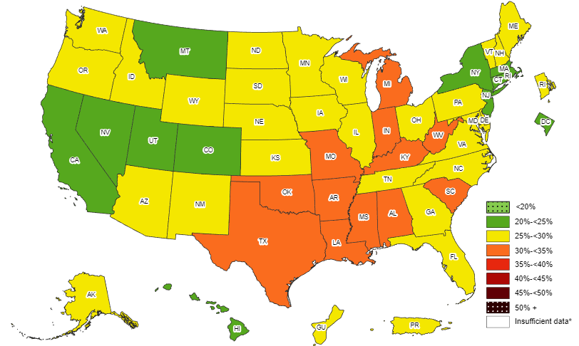
Prevalence¶ of Obesity Based on Self-Reported Weight and Height Among US Adults by State and Territory, BRFSS, 2011
¶ Prevalence estimates reflect BRFSS methodological changes started in 2011. These estimates should not be
compared to prevalence estimates before 2011.
*Sample size <50, the relative standard error (dividing the standard error by the prevalence) ≥30%, or no data in a specific year.

Slide 6
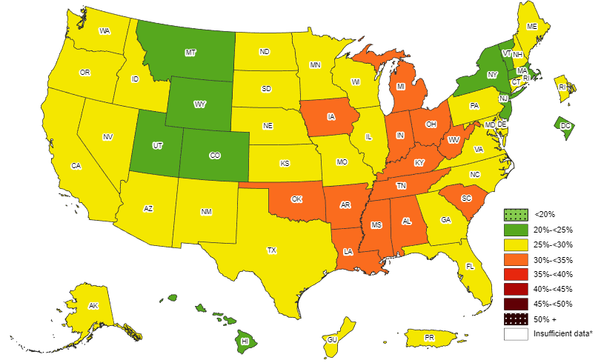
Prevalence¶ of Obesity Based on Self-Reported Weight and Height Among US Adults by State and Territory, BRFSS, 2012
¶ Prevalence estimates reflect BRFSS methodological changes started in 2011. These estimates should not be
compared to prevalence estimates before 2011.
*Sample size <50, the relative standard error (dividing the standard error by the prevalence) ≥30%, or no data in a specific year.

Slide 7
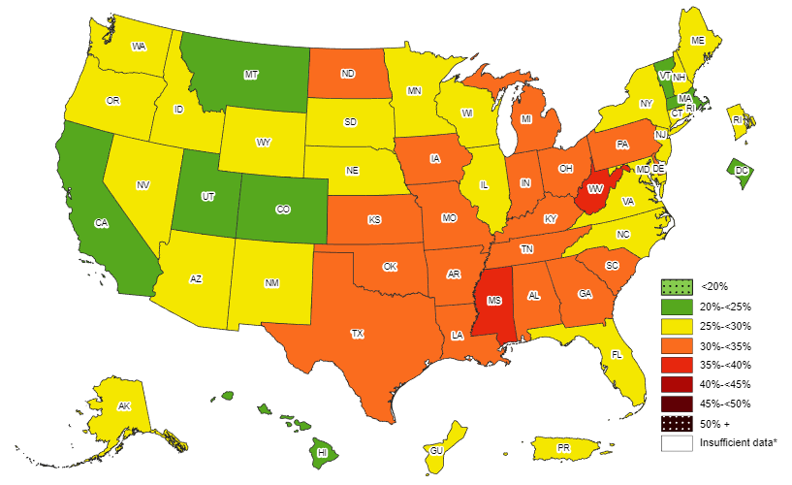
Prevalence¶ of Obesity Based on Self-Reported Weight and Height Among US Adults by State and Territory, BRFSS, 2013
¶ Prevalence estimates reflect BRFSS methodological changes started in 2011. These estimates should not be
compared to prevalence estimates before 2011.
*Sample size <50, the relative standard error (dividing the standard error by the prevalence) ≥30%, or no data in a specific year.

Slide 8
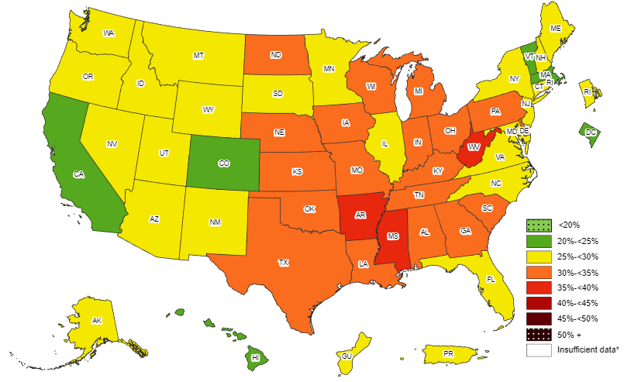
Prevalence¶ of Obesity Based on Self-Reported Weight and Height Among US Adults by State and Territory, BRFSS, 2014
¶ Prevalence estimates reflect BRFSS methodological changes started in 2011. These estimates should not be
compared to prevalence estimates before 2011.
*Sample size <50, the relative standard error (dividing the standard error by the prevalence) ≥30%, or no data in a specific year.

Slide 9
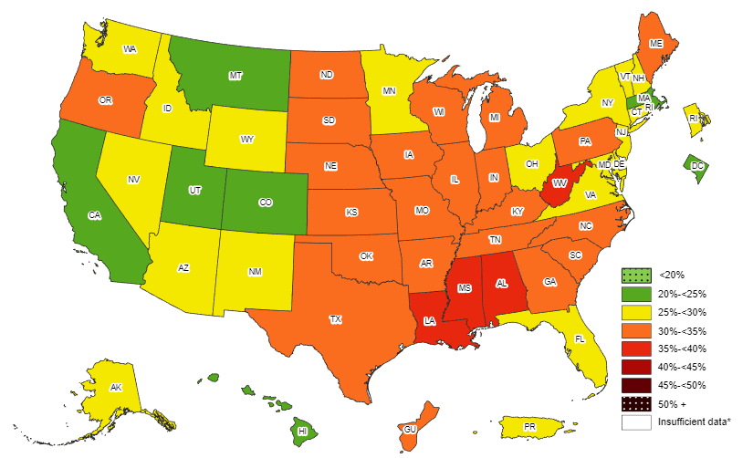
Prevalence¶ of Obesity Based on Self-Reported Weight and Height Among US Adults by State and Territory, BRFSS, 2015
¶ Prevalence estimates reflect BRFSS methodological changes started in 2011. These estimates should not be
compared to prevalence estimates before 2011.
*Sample size <50, the relative standard error (dividing the standard error by the prevalence) ≥30%, or no data in a specific year.

Slide 10
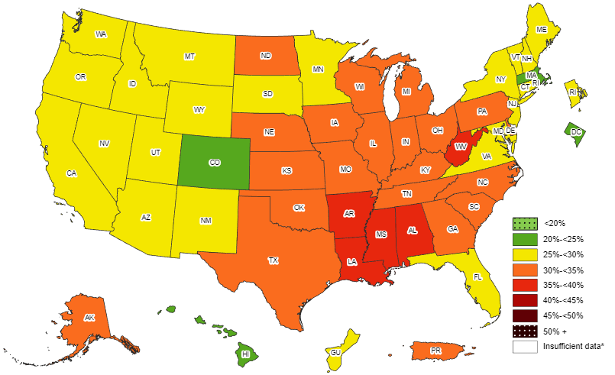
Prevalence¶ of Obesity Based on Self-Reported Weight and Height Among US Adults by State and Territory, BRFSS, 2016
¶ Prevalence estimates reflect BRFSS methodological changes started in 2011. These estimates should not be
compared to prevalence estimates before 2011.
*Sample size <50, the relative standard error (dividing the standard error by the prevalence) ≥30%, or no data in a specific year.

Slide 11
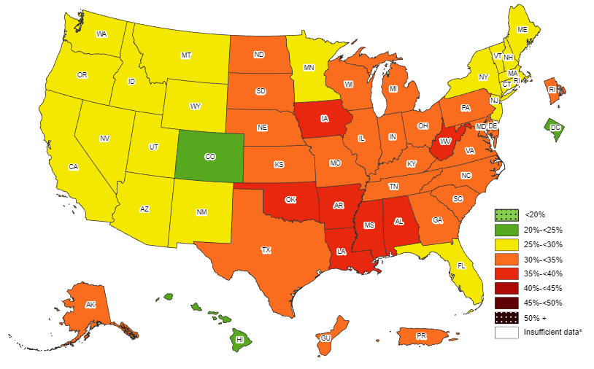
Prevalence¶ of Obesity Based on Self-Reported Weight and Height Among US Adults by State and Territory, BRFSS, 2017
¶ Prevalence estimates reflect BRFSS methodological changes started in 2011. These estimates should not be
compared to prevalence estimates before 2011.
*Sample size <50, the relative standard error (dividing the standard error by the prevalence) ≥30%, or no data in a specific year.

Slide 12
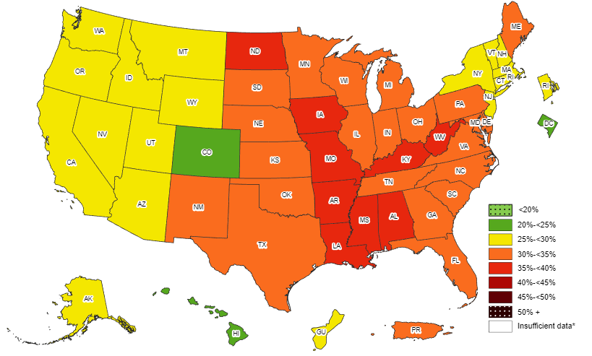
Prevalence¶ of Obesity Based on Self-Reported Weight and Height Among US Adults by State and Territory, BRFSS, 2018
¶ Prevalence estimates reflect BRFSS methodological changes started in 2011. These estimates should not be
compared to prevalence estimates before 2011.
*Sample size <50, the relative standard error (dividing the standard error by the prevalence) ≥30%, or no data in a specific year.

Slide 13
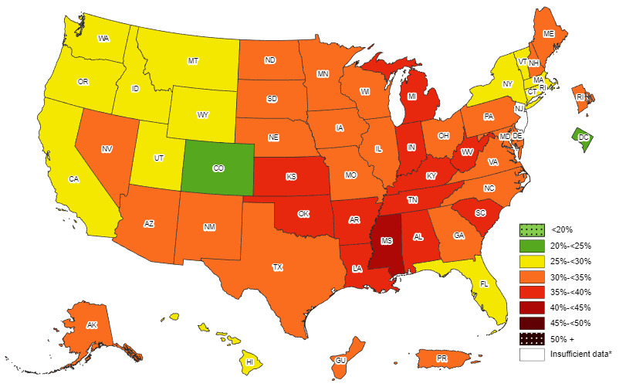
Prevalence¶ of Obesity Based on Self-Reported Weight and Height Among US Adults by State and Territory, BRFSS, 2019
¶ Prevalence estimates reflect BRFSS methodological changes started in 2011. These estimates should not be
compared to prevalence estimates before 2011.
*Sample size <50, the relative standard error (dividing the standard error by the prevalence) ≥30%, or no data in a specific year.

Slide 14
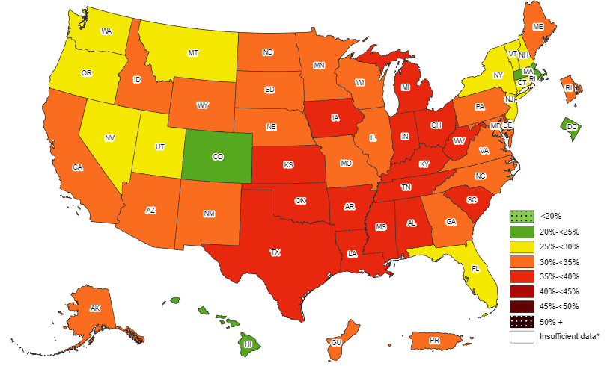
Prevalence¶ of Obesity Based on Self-Reported Weight and Height Among US Adults by State and Territory, BRFSS, 2020
¶ Prevalence estimates reflect BRFSS methodological changes started in 2011. These estimates should not be
compared to prevalence estimates before 2011.
*Sample size <50, the relative standard error (dividing the standard error by the prevalence) ≥30%, or no data in a specific year.

Slide 15
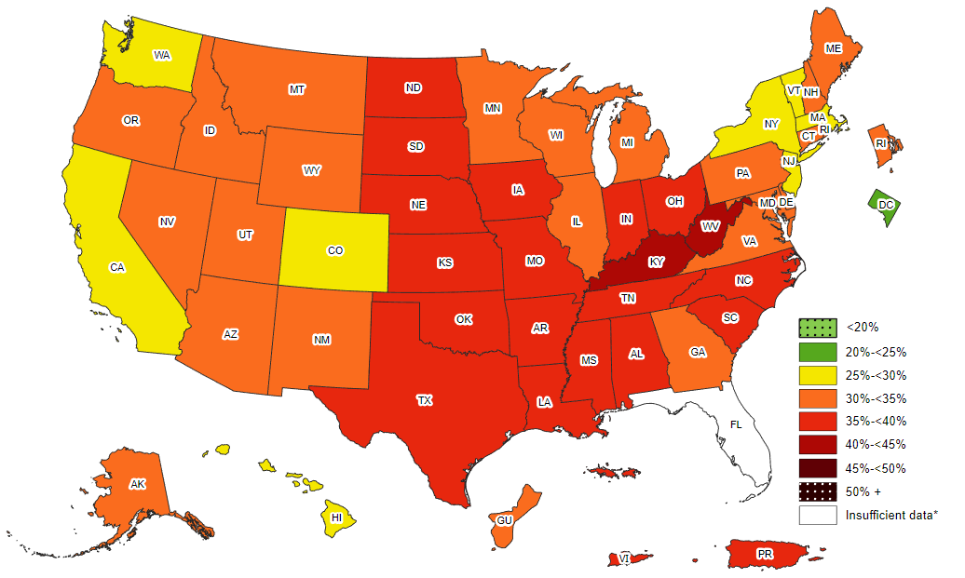
Prevalence¶ of Obesity Based on Self-Reported Weight and Height Among US Adults by State and Territory, BRFSS, 2021
¶ Prevalence estimates reflect BRFSS methodological changes started in 2011. These estimates should not be
compared to prevalence estimates before 2011.
*Sample size <50, the relative standard error (dividing the standard error by the prevalence) ≥30%, or no data in a specific year.

Slide 16
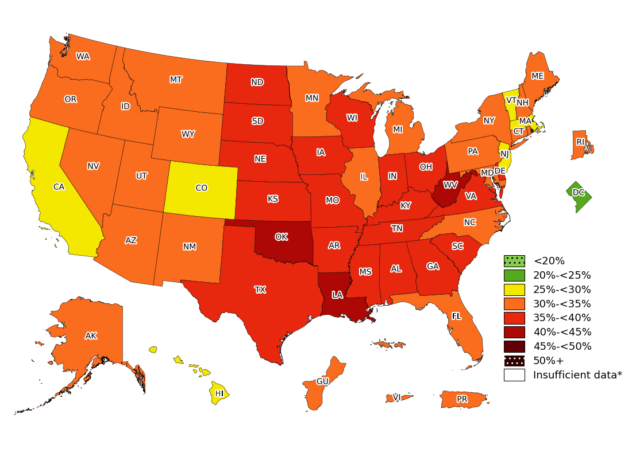
Prevalence¶ of Obesity Based on Self-Reported Weight and Height Among US Adults by State and Territory, BRFSS, 2022
¶ Prevalence estimates reflect BRFSS methodological changes started in 2011. These estimates should not be
compared to prevalence estimates before 2011.
*Sample size <50, the relative standard error (dividing the standard error by the prevalence) ≥30%, or no data in a specific year.

Slide 17
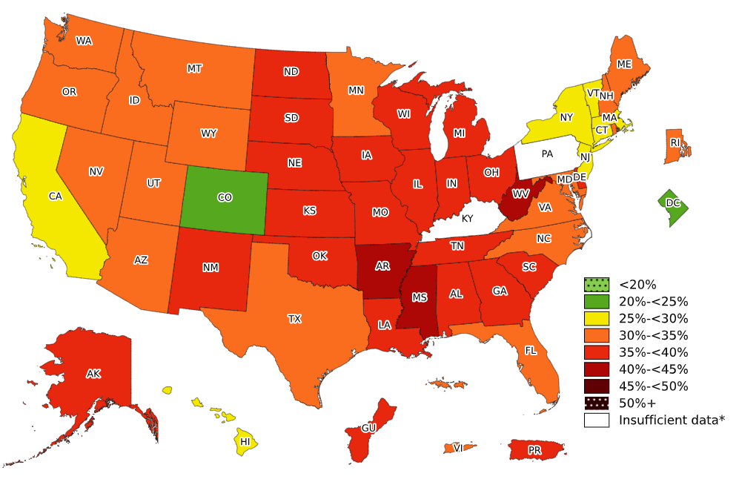
Prevalence¶ of Obesity Based on Self-Reported Weight and Height Among US Adults by State and Territory, BRFSS, 2023
¶ Prevalence estimates reflect BRFSS methodological changes started in 2011. These estimates should not be
compared to prevalence estimates before 2011.
*Sample size <50, the relative standard error (dividing the standard error by the prevalence) ≥30%, or no data in a specific year.

Slide 18
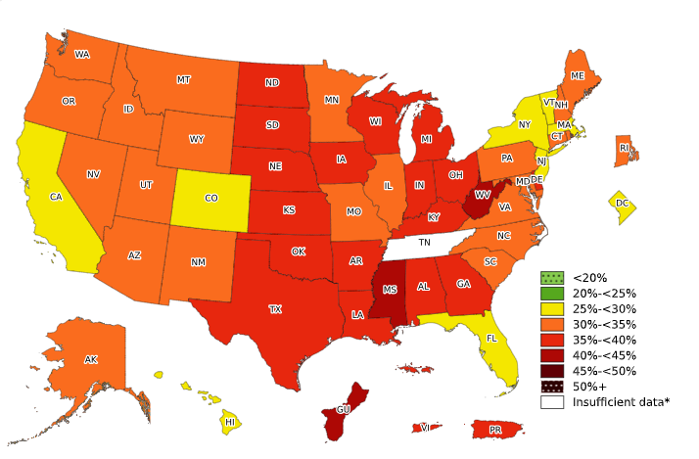

Prevalence¶ of Obesity Based on Self-Reported Weight and Height Among US Adults by State and Territory, BRFSS, 2024
¶ Prevalence estimates reflect BRFSS methodological changes started in 2011. These estimates should not be
compared to prevalence estimates before 2011.
*Sample size <50, the relative standard error (dividing the standard error by the prevalence) ≥30%, or no data in a specific year.

Slide 19
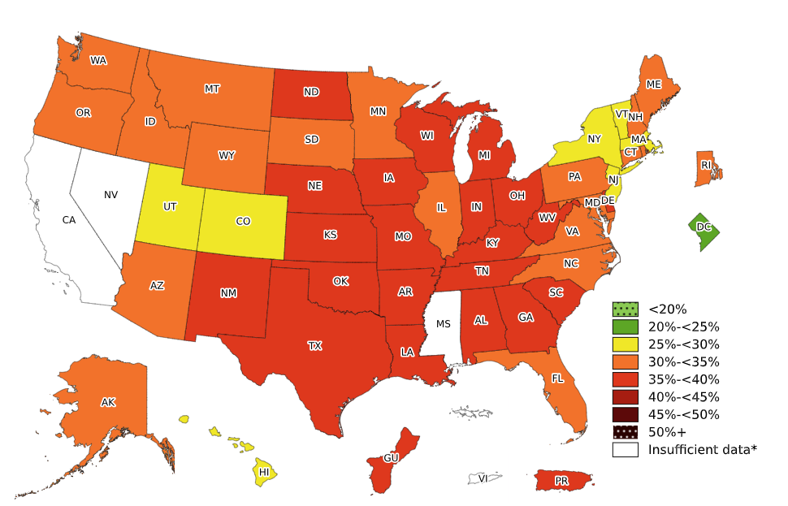
Prevalence¶ of Obesity Based on Self-Reported Weight and Height Among US Adults by State and Territory, BRFSS, 2025
¶ Prevalence estimates reflect BRFSS methodological changes started in 2011. These estimates should not be
compared to prevalence estimates before 2011.
*Sample size <50, the relative standard error (dividing the standard error by the prevalence) ≥30%, or no data in a specific year.

Slide 20
Prevalence¶ of Obesity Based on Self-Reported Weight and Height Among US Adults by State and Territory, BRFSS, 2011
State | Prevalence | 95% Confidence Interval
Alabama | 32.0 | (30.5, 33.5)
Alaska | 27.4 | (25.3, 29.7)
Arizona | 25.1 | (23.0, 27.3)
Arkansas | 30.9 | (28.8, 33.1)
California | 23.8 | (22.9, 24.7)
Colorado | 20.7 | (19.7, 21.8)
Connecticut | 24.5 | (23.0, 26.0)
Delaware | 28.8 | (26.9, 30.7)
District of Columbia | 23.7 | (21.9, 25.7)
Florida | 26.6 | (25.4, 27.9)
Georgia | 28.0 | (26.6, 29.4)
Guam | 27.4 | (24.8, 30.2)
Hawaii | 21.8 | (20.4, 23.4)
Idaho | 27.0 | (25.3, 28.9)
Illinois | 27.1 | (25.4, 28.9)
Indiana | 30.8 | (29.5, 32.3)
Iowa | 29.0 | (27.6, 30.3)
Kansas | 29.6 | (28.7, 30.4)
Kentucky | 30.4 | (28.9, 31.9)
Louisiana | 33.4 | (32.0, 34.9)
Maine | 27.8 | (26.8, 28.9)
Maryland | 28.3 | (26.9, 29.7)
Massachusetts | 22.7 | (21.8, 23.7)
Michigan | 31.3 | (30.0, 32.6)
Minnesota | 25.7 | (24.6, 26.8)
Mississippi | 34.9 | (33.5, 36.3)
State | Prevalence | 95% Confidence Interval
Missouri | 30.3 | (28.6, 32.0)
Montana | 24.6 | (23.3, 26.0)
Nebraska | 28.4 | (27.6, 29.2)
Nevada | 24.5 | (22.5, 26.6)
New Hampshire | 26.2 | (24.7, 27.7)
New Jersey | 23.7 | (22.7, 24.8)
New Mexico | 26.3 | (25.1, 27.6)
New York | 24.5 | (23.2, 25.9)
North Carolina | 29.1 | (27.7, 30.6)
North Dakota | 27.8 | (26.3, 29.4)
Ohio | 29.6 | (28.3, 31.0)
Oklahoma | 31.1 | (29.7, 32.5)
Oregon | 26.7 | (25.2, 28.3)
Pennsylvania | 28.6 | (27.3, 29.8)
Puerto Rico | 26.3 | (25.0, 27.7)
Rhode Island | 25.4 | (23.9, 27.0)
South Carolina | 30.8 | (29.6, 32.1)
South Dakota | 28.1 | (26.3, 30.1)
Tennessee | 29.2 | (26.8, 31.7)
Texas | 30.4 | (29.1, 31.8)
Utah | 24.4 | (23.4, 25.5)
Vermont | 25.4 | (24.1, 26.8)
Virginia | 29.2 | (27.5, 30.9)
Washington | 26.5 | (25.3, 27.7)
West Virginia | 32.4 | (30.9, 34.0)
Wisconsin | 27.7 | (25.8, 29.7)
Wyoming | 25.0 | (23.5, 26.6)
¶ Prevalence estimates reflect BRFSS methodological changes started in 2011. These estimates should not be compared to prevalence estimates before 2011. Source: Behavioral Risk Factor Surveillance System, CDC.

Slide 21
Prevalence¶ of Obesity Based on Self-Reported Weight and Height Among US Adults by State and Territory, BRFSS, 2012
State | Prevalence | 95% Confidence Interval
Alabama | 33.0 | (31.5, 34.4)
Alaska | 25.7 | (23.9, 27.5)
Arizona | 26.0 | (24.3, 27.8)
Arkansas | 34.5 | (32.7, 36.4)
California | 25.0 | (23.9, 26.0)
Colorado | 20.5 | (19.5, 21.4)
Connecticut | 25.6 | (24.3, 26.9)
Delaware | 26.9 | (25.2, 28.6)
District of Columbia | 21.9 | (19.8, 24.0)
Florida | 25.2 | (23.6, 26.7)
Georgia | 29.1 | (27.4, 30.8)
Guam | 29.1 | (26.3, 31.9)
Hawaii | 23.6 | (22.0, 25.1)
Idaho | 26.8 | (24.8, 28.8)
Illinois | 28.1 | (26.4, 29.9)
Indiana | 31.4 | (30.1, 32.7)
Iowa | 30.4 | (29.1, 31.8)
Kansas | 29.9 | (28.7, 31.0)
Kentucky | 31.3 | (29.9, 32.6)
Louisiana | 34.7 | (33.1, 36.4)
Maine | 28.4 | (27.2, 29.5)
Maryland | 27.6 | (26.3, 28.9)
Massachusetts | 22.9 | (22.0, 23.8)
Michigan | 31.1 | (29.8, 32.3)
Minnesota | 25.7 | (24.7, 26.8)
Mississippi | 34.6 | (33.0, 36.2)
State | Prevalence | 95% Confidence Interval
Missouri | 29.6 | (28.0, 31.2)
Montana | 24.3 | (23.1, 25.5)
Nebraska | 28.6 | (27.7, 29.6)
Nevada | 26.2 | (24.3, 28.1)
New Hampshire | 27.3 | (25.8, 28.8)
New Jersey | 24.6 | (23.6, 25.6)
New Mexico | 27.1 | (25.9, 28.3)
New York | 23.6 | (22.0, 25.1)
North Carolina | 29.6 | (28.5, 30.7)
North Dakota | 29.7 | (27.9, 31.4)
Ohio | 30.1 | (29.0, 31.2)
Oklahoma | 32.2 | (30.8, 33.6)
Oregon | 27.3 | (25.7, 29.0)
Pennsylvania | 29.1 | (28.1, 30.1)
Puerto Rico | 28.4 | (27.0, 29.7)
Rhode Island | 25.7 | (24.1, 27.4)
South Carolina | 31.6 | (30.4, 32.8)
South Dakota | 28.1 | (26.5, 29.8)
Tennessee | 31.1 | (29.6, 32.7)
Texas | 29.2 | (27.8, 30.5)
Utah | 24.3 | (23.3, 25.3)
Vermont | 23.7 | (22.3, 25.1)
Virginia | 27.4 | (26.0, 28.7)
Washington | 26.8 | (25.8, 27.8)
West Virginia | 33.8 | (32.2, 35.4)
Wisconsin | 29.7 | (27.8, 31.6)
Wyoming | 24.6 | (22.8, 26.4)
¶ Prevalence estimates reflect BRFSS methodological changes started in 2011. These estimates should not be compared to prevalence estimates before 2011. Source: Behavioral Risk Factor Surveillance System, CDC.

Slide 22
Prevalence¶ of Obesity Based on Self-Reported Weight and Height Among US Adults by State and Territory, BRFSS, 2013
State | Prevalence | 95% Confidence Interval
Alabama | 32.4 | (30.8, 34.1)
Alaska | 28.4 | (26.5, 30.4)
Arizona | 26.8 | (24.3, 29.4)
Arkansas | 34.6 | (32.7, 36.6)
California | 24.1 | (23.0, 25.3)
Colorado | 21.3 | (20.4, 22.2)
Connecticut | 25.0 | (23.5, 26.4)
Delaware | 31.1 | (29.3, 32.8)
District of Columbia | 22.9 | (21.0, 24.8)
Florida | 26.4 | (25.3, 27.4)
Georgia | 30.3 | (28.9, 31.8)
Guam | 27.0 | (24.4, 29.8)
Hawaii | 21.8 | (20.4, 23.2)
Idaho | 29.6 | (27.8, 31.4)
Illinois | 29.4 | (27.7, 31.2)
Indiana | 31.8 | (30.6, 33.1)
Iowa | 31.3 | (29.9, 32.7)
Kansas | 30.0 | (29.2, 30.7)
Kentucky | 33.2 | (31.8, 34.6)
Louisiana | 33.1 | (31.1, 35.2)
Maine | 28.9 | (27.5, 30.2)
Maryland | 28.3 | (27.0, 29.5)
Massachusetts | 23.6 | (22.5, 24.8)
Michigan | 31.5 | (30.4, 32.6)
Minnesota | 25.5 | (24.1, 26.8)
Mississippi | 35.1 | (33.5, 36.8)
State | Prevalence | 95% Confidence Interval
Missouri | 30.4 | (28.8, 32.1)
Montana | 24.6 | (23.4, 25.8)
Nebraska | 29.6 | (28.4, 30.7)
Nevada | 26.2 | (24.0, 28.6)
New Hampshire | 26.7 | (25.3, 28.3)
New Jersey | 26.3 | (25.1, 27.5)
New Mexico | 26.4 | (25.1, 27.7)
New York | 25.4 | (24.2, 26.6)
North Carolina | 29.4 | (28.1, 30.7)
North Dakota | 31.0 | (29.5, 32.5)
Ohio | 30.4 | (29.2, 31.6)
Oklahoma | 32.5 | (31.2, 33.9)
Oregon | 26.5 | (24.9, 28.1)
Pennsylvania | 30.0 | (28.9, 31.2)
Puerto Rico | 27.9 | (26.4, 29.5)
Rhode Island | 27.3 | (25.8, 28.8)
South Carolina | 31.7 | (30.5, 33.1)
South Dakota | 29.9 | (28.0, 31.8)
Tennessee | 33.7 | (31.9, 35.5)
Texas | 30.9 | (29.5, 32.3)
Utah | 24.1 | (23.2, 25.1)
Vermont | 24.7 | (23.4, 26.1)
Virginia | 27.2 | (25.9, 28.5)
Washington | 27.2 | (26.0, 28.3)
West Virginia | 35.1 | (33.6, 36.6)
Wisconsin | 29.8 | (28.0, 31.6)
Wyoming | 27.8 | (26.2, 29.5)
¶ Prevalence estimates reflect BRFSS methodological changes started in 2011. These estimates should not be compared to prevalence estimates before 2011. Source: Behavioral Risk Factor Surveillance System, CDC.

Slide 23
Prevalence¶ of Obesity Based on Self-Reported Weight and Height Among US Adults by State and Territory, BRFSS, 2014
State | Prevalence | 95% Confidence Interval
Alabama | 33.5 | (32.1, 35.0)
Alaska | 29.7 | (27.8, 31.7)
Arizona | 28.9 | (27.7, 30.2)
Arkansas | 35.9 | (33.8, 38.0)
California | 24.7 | (23.5, 25.9)
Colorado | 21.3 | (20.4, 22.2)
Connecticut | 26.3 | (24.9, 27.7)
Delaware | 30.7 | (28.6, 32.8)
District of Columbia | 21.7 | (19.5, 24.0)
Florida | 26.2 | (25.0, 27.5)
Georgia | 30.5 | (28.9, 32.1)
Guam | 28.0 | (25.6, 30.5)
Hawaii | 22.1 | (20.7, 23.5)
Idaho | 28.9 | (27.1, 30.8)
Illinois | 29.3 | (27.6, 31.1)
Indiana | 32.7 | (31.6, 34.0)
Iowa | 30.9 | (29.6, 32.3)
Kansas | 31.3 | (30.3, 32.2)
Kentucky | 31.6 | (30.2, 33.1)
Louisiana | 34.9 | (33.4, 36.4)
Maine | 28.2 | (26.9, 29.5)
Maryland | 29.6 | (28.1, 31.1)
Massachusetts | 23.3 | (22.3, 24.4)
Michigan | 30.7 | (29.4, 32.0)
Minnesota | 27.6 | (26.8, 28.5)
Mississippi | 35.5 | (33.4, 37.6)
State | Prevalence | 95% Confidence Interval
Missouri | 30.2 | (28.6, 31.9)
Montana | 26.4 | (24.9, 27.9)
Nebraska | 30.2 | (29.2, 31.3)
Nevada | 27.7 | (25.4, 30.1)
New Hampshire | 27.4 | (25.8, 29.1)
New Jersey | 26.9 | (25.7, 28.1)
New Mexico | 28.4 | (27.0, 30.0)
New York | 27.0 | (25.6, 28.5)
North Carolina | 29.7 | (28.4, 31.0)
North Dakota | 32.2 | (30.5, 34.0)
Ohio | 32.6 | (31.2, 34.1)
Oklahoma | 33.0 | (31.7, 34.3)
Oregon | 27.9 | (26.3, 29.6)
Pennsylvania | 30.2 | (28.9, 31.4)
Puerto Rico | 28.3 | (26.8, 29.8)
Rhode Island | 27.0 | (25.4, 28.6)
South Carolina | 32.1 | (30.9, 33.3)
South Dakota | 29.8 | (27.9, 31.8)
Tennessee | 31.2 | (29.3, 33.2)
Texas | 31.9 | (30.6, 33.3)
Utah | 25.7 | (24.9, 26.6)
Vermont | 24.8 | (23.5, 26.1)
Virginia | 28.5 | (27.2, 29.7)
Washington | 27.3 | (26.0, 28.5)
West Virginia | 35.7 | (34.2, 37.2)
Wisconsin | 31.2 | (29.6, 32.8)
Wyoming | 29.5 | (27.5, 31.5)
¶ Prevalence estimates reflect BRFSS methodological changes started in 2011. These estimates should not be compared to prevalence estimates before 2011. Source: Behavioral Risk Factor Surveillance System, CDC.

Slide 24
Prevalence¶ of Obesity Based on Self-Reported Weight and Height Among US Adults by State and Territory, BRFSS, 2015
State | Prevalence | 95% Confidence Interval
Alabama | 35.6 | (34.1, 37.2)
Alaska | 29.8 | (27.5, 32.3)
Arizona | 28.4 | (26.9, 30.0)
Arkansas | 34.5 | (32.2, 36.9)
California | 24.2 | (23.2, 25.2)
Colorado | 20.2 | (19.1, 21.3)
Connecticut | 25.3 | (24.1, 26.4)
Delaware | 29.7 | (27.6, 31.8)
District of Columbia | 22.1 | (19.7, 24.8)
Florida | 26.8 | (25.5, 28.1)
Georgia | 30.7 | (28.8, 32.6)
Guam | 31.6 | (28.2, 35.1)
Hawaii | 22.7 | (21.3, 24.1)
Idaho | 28.6 | (26.9, 30.4)
Illinois | 30.8 | (29.2, 32.4)
Indiana | 31.3 | (29.5, 33.1)
Iowa | 32.1 | (30.5, 33.8)
Kansas | 34.2 | (33.4, 35.0)
Kentucky | 34.6 | (32.9, 36.3)
Louisiana | 36.2 | (34.3, 38.1)
Maine | 30.0 | (28.6, 31.4)
Maryland | 28.9 | (27.2, 30.7)
Massachusetts | 24.3 | (23.0, 25.6)
Michigan | 31.2 | (29.9, 32.4)
Minnesota | 26.1 | (25.3, 27.0)
Mississippi | 35.6 | (33.8, 37.5)
State | Prevalence | 95% Confidence Interval
Missouri | 32.4 | (30.8, 34.0)
Montana | 23.6 | (22.1, 25.2)
Nebraska | 31.4 | (30.3, 32.5)
Nevada | 26.7 | (24.1, 29.5)
New Hampshire | 26.3 | (24.8, 27.9)
New Jersey | 25.6 | (24.3, 26.9)
New Mexico | 28.8 | (27.1, 30.6)
New York | 25.0 | (24.0, 26.1)
North Carolina | 30.1 | (28.7, 31.5)
North Dakota | 31.0 | (29.3, 32.8)
Ohio | 29.8 | (28.4, 31.2)
Oklahoma | 33.9 | (32.2, 35.6)
Oregon | 30.1 | (28.4, 31.8)
Pennsylvania | 30.0 | (28.4, 31.6)
Puerto Rico | 29.5 | (28.0, 31.1)
Rhode Island | 26.0 | (24.3, 27.7)
South Carolina | 31.7 | (30.5, 33.0)
South Dakota | 30.4 | (28.5, 32.3)
Tennessee | 33.8 | (31.9, 35.7)
Texas | 32.4 | (30.9, 33.9)
Utah | 24.5 | (23.5, 25.5)
Vermont | 25.1 | (23.8, 26.6)
Virginia | 29.2 | (27.9, 30.6)
Washington | 26.4 | (25.5, 27.4)
West Virginia | 35.6 | (34.1, 37.1)
Wisconsin | 30.7 | (29.0, 32.4)
Wyoming | 29.0 | (27.0, 31.1)
¶ Prevalence estimates reflect BRFSS methodological changes started in 2011. These estimates should not be compared to prevalence estimates before 2011. Source: Behavioral Risk Factor Surveillance System, CDC.

Slide 25
Prevalence¶ of Obesity Based on Self-Reported Weight and Height Among US Adults by State and Territory, BRFSS, 2016
State | Prevalence | 95% Confidence Interval
Alabama | 35.7 | (34.2, 37.3)
Alaska | 31.4 | (28.5, 34.4)
Arizona | 29.0 | (27.5, 30.6)
Arkansas | 35.7 | (33.3, 38.1)
California | 25.0 | (23.9, 26.1)
Colorado | 22.3 | (21.4, 23.2)
Connecticut | 26.0 | (24.8, 27.2)
Delaware | 30.7 | (28.7, 32.8)
District of Columbia | 22.6 | (20.9, 24.3)
Florida | 27.4 | (26.4, 28.5)
Georgia | 31.4 | (29.7, 33.2)
Guam | 28.3 | (25.1, 31.7)
Hawaii | 23.8 | (22.5, 25.2)
Idaho | 27.4 | (25.6, 29.3)
Illinois | 31.6 | (29.9, 33.3)
Indiana | 32.5 | (31.2, 33.8)
Iowa | 32.0 | (30.5, 33.4)
Kansas | 31.2 | (30.1, 32.3)
Kentucky | 34.2 | (32.7, 35.6)
Louisiana | 35.5 | (33.4, 37.7)
Maine | 29.9 | (28.5, 31.3)
Maryland | 29.9 | (28.9, 31.0)
Massachusetts | 23.6 | (22.3, 24.9)
Michigan | 32.5 | (31.4, 33.6)
Minnesota | 27.8 | (26.9, 28.6)
Mississippi | 37.3 | (35.4, 39.1)
Missouri | 31.7 | (30.0, 33.4)
State | Prevalence | 95% Confidence Interval
Montana | 25.5 | (23.9, 27.2)
Nebraska | 32.0 | (30.8, 33.2)
Nevada | 25.8 | (23.9, 27.8)
New Hampshire | 26.6 | (25.0, 28.2)
New Jersey | 27.4 | (25.7, 29.1)
New Mexico | 28.3 | (26.6, 30.1)
New York | 25.5 | (24.6, 26.5)
North Carolina | 31.8 | (30.4, 33.3)
North Dakota | 31.9 | (30.3, 33.6)
Ohio | 31.5 | (30.2, 32.8)
Oklahoma | 32.8 | (31.2, 34.3)
Oregon | 28.7 | (27.3, 30.3)
Pennsylvania | 30.3 | (28.8, 31.8)
Puerto Rico | 30.7 | (29.0, 32.5)
Rhode Island | 26.6 | (24.9, 28.4)
South Carolina | 32.3 | (31.0, 33.6)
South Dakota | 29.6 | (27.6, 31.7)
Tennessee | 34.8 | (33.0, 36.7)
Texas | 33.7 | (31.9, 35.4)
Utah | 25.4 | (24.2, 26.5)
Vermont | 27.1 | (25.5, 28.7)
Virgin Islands | 32.5 | (28.6, 36.6)
Virginia | 29.0 | (27.7, 30.3)
Washington | 28.6 | (27.6, 29.6)
West Virginia | 37.7 | (36.3, 39.0)
Wisconsin | 30.7 | (29.0, 32.5)
Wyoming | 27.7 | (25.7, 29.8)
¶ Prevalence estimates reflect BRFSS methodological changes started in 2011. These estimates should not be compared to prevalence estimates before 2011. Source: Behavioral Risk Factor Surveillance System, CDC.

Slide 26
Prevalence¶ of Obesity Based on Self-Reported Weight and Height Among US Adults by State and Territory, BRFSS, 2017
State | Prevalence | 95% Confidence Interval
Alabama | 36.3 | (34.7, 38.0)
Alaska | 34.2 | (31.4, 37.1)
Arizona | 29.5 | (28.5, 30.5)
Arkansas | 35.0 | (32.6, 37.5)
California | 25.1 | (23.8, 26.4)
Colorado | 22.6 | (21.6, 23.7)
Connecticut | 26.9 | (25.6, 28.1)
Delaware | 31.8 | (29.7, 34.0)
District of Columbia | 22.9 | (21.1, 24.7)
Florida | 28.4 | (27.0, 29.9)
Georgia | 31.6 | (30.0, 33.3)
Guam | 34.3 | (31.2, 37.6)
Hawaii | 23.8 | (22.4, 25.2)
Idaho | 29.3 | (27.5, 31.2)
Illinois | 31.1 | (29.5, 32.7)
Indiana | 33.6 | (32.5, 34.7)
Iowa | 36.4 | (35.1, 37.7)
Kansas | 32.4 | (31.5, 33.2)
Kentucky | 34.3 | (32.6, 36.0)
Louisiana | 36.2 | (34.4, 38.1)
Maine | 29.1 | (27.7, 30.6)
Maryland | 31.3 | (30.0, 32.6)
Massachusetts | 25.9 | (24.1, 27.7)
Michigan | 32.3 | (31.1, 33.4)
Minnesota | 28.4 | (27.5, 29.4)
Mississippi | 37.3 | (35.3, 39.3)
Missouri | 32.5 | (30.9, 34.0)
State | Prevalence | 95% Confidence Interval
Montana | 25.3 | (23.8, 26.9)
Nebraska | 32.8 | (31.6, 34.0)
Nevada | 26.7 | (24.5, 29.0)
New Hampshire | 28.1 | (26.3, 29.9)
New Jersey | 27.3 | (25.8, 28.7)
New Mexico | 28.4 | (26.8, 30.0)
New York | 25.7 | (24.6, 26.9)
North Carolina | 32.1 | (30.4, 34.0)
North Dakota | 33.2 | (31.6, 34.7)
Ohio | 33.8 | (32.5, 35.1)
Oklahoma | 36.5 | (34.9, 38.1)
Oregon | 29.4 | (27.9, 30.9)
Pennsylvania | 31.6 | (30.0, 33.2)
Puerto Rico | 32.9 | (31.0, 34.9)
Rhode Island | 30.0 | (28.1, 31.9)
South Carolina | 34.1 | (32.8, 35.4)
South Dakota | 31.9 | (29.8, 34.1)
Tennessee | 32.8 | (31.1, 34.6)
Texas | 33.0 | (31.2, 34.9)
Utah | 25.3 | (24.2, 26.4)
Vermont | 27.6 | (26.0, 29.2)
Virginia | 30.1 | (28.7, 31.4)
Washington | 27.7 | (26.6, 28.7)
West Virginia | 38.1 | (36.4, 39.7)
Wisconsin | 32.0 | (30.3, 33.8)
Wyoming | 28.8 | (27.1, 30.6)
¶ Prevalence estimates reflect BRFSS methodological changes started in 2011. These estimates should not be compared to prevalence estimates before 2011. Source: Behavioral Risk Factor Surveillance System, CDC.

Slide 27
Prevalence¶ of Obesity Based on Self-Reported Weight and Height Among US Adults by State and Territory, BRFSS, 2018
State | Prevalence | 95% Confidence Interval
Alabama | 36.2 | (34.6, 37.9)
Alaska | 29.5 | (27.0, 32.2)
Arizona | 29.5 | (27.8, 31.3)
Arkansas | 37.1 | (35.1, 39.1)
California | 25.8 | (24.8, 26.9)
Colorado | 23.0 | (21.9, 24.0)
Connecticut | 27.4 | (26.2, 28.7)
Delaware | 33.5 | (31.7, 35.4)
District of Columbia | 24.7 | (22.9, 26.5)
Florida | 30.7 | (29.1, 32.3)
Georgia | 32.5 | (31.2, 33.8)
Guam | 29.8 | (26.6, 33.3)
Hawaii | 24.9 | (23.6, 26.3)
Idaho | 28.4 | (26.3, 30.5)
Illinois | 31.8 | (30.2, 33.4)
Indiana | 34.1 | (32.6, 35.6)
Iowa | 35.3 | (34.2, 36.5)
Kansas | 34.4 | (33.2, 35.6)
Kentucky | 36.6 | (34.9, 38.4)
Louisiana | 36.8 | (34.9, 38.7)
Maine | 30.4 | (28.9, 31.9)
Maryland | 30.9 | (29.8, 32.1)
Massachusetts | 25.7 | (24.3, 27.2)
Michigan | 33.0 | (31.8, 34.2)
Minnesota | 30.1 | (29.2, 30.9)
Mississippi | 39.5 | (37.8, 41.2)
Missouri | 35.0 | (33.3, 36.8)
State | Prevalence | 95% Confidence Interval
Montana | 26.9 | (25.2, 28.5)
Nebraska | 34.1 | (32.9, 35.3)
Nevada | 29.5 | (27.1, 32.0)
New Hampshire | 29.6 | (27.9, 31.4)
New Jersey | 25.7 | (23.3, 28.2)
New Mexico | 32.3 | (30.7, 34.0)
New York | 27.6 | (26.7, 28.6)
North Carolina | 33.0 | (31.2, 34.8)
North Dakota | 35.1 | (33.3, 37.0)
Ohio | 34.0 | (32.7, 35.3)
Oklahoma | 34.8 | (33.1, 36.6)
Oregon | 29.9 | (28.4, 31.4)
Pennsylvania | 30.9 | (29.4, 32.5)
Puerto Rico | 32.9 | (31.2, 34.7)
Rhode Island | 27.7 | (26.0, 29.5)
South Carolina | 34.3 | (33.0, 35.6)
South Dakota | 30.1 | (28.1, 32.1)
Tennessee | 34.4 | (32.5, 36.3)
Texas | 34.8 | (32.8, 36.8)
Utah | 27.8 | (26.7, 28.9)
Vermont | 27.5 | (25.9, 29.2)
Virginia | 30.4 | (29.1, 31.6)
Washington | 28.7 | (27.6, 29.8)
West Virginia | 39.5 | (37.8, 41.3)
Wisconsin | 32.0 | (30.2, 33.8)
Wyoming | 29.0 | (27.3, 30.8)
¶ Prevalence estimates reflect BRFSS methodological changes started in 2011. These estimates should not be compared to prevalence estimates before 2011. Source: Behavioral Risk Factor Surveillance System, CDC.

Slide 28
Prevalence¶ of Obesity Based on Self-Reported Weight and Height Among US Adults by State and Territory, BRFSS, 2019
State | Prevalence | 95% Confidence Interval
Alabama | 36.1 | (34.6, 37.7)
Alaska | 30.5 | (27.8, 33.4)
Arizona | 31.4 | (29.7, 33.2)
Arkansas | 37.4 | (35.5, 39.4)
California | 26.2 | (25.1, 27.2)
Colorado | 23.8 | (22.7, 24.9)
Connecticut | 29.1 | (27.8, 30.5)
Delaware | 34.4 | (32.1, 36.6)
District of Columbia | 23.8 | (21.7, 25.9)
Florida | 27.0 | (25.6, 28.5)
Georgia | 33.1 | (31.3, 35.0)
Guam | 33.6 | (30.5, 37.0)
Hawaii | 25.0 | (23.7, 26.3)
Idaho | 29.5 | (27.6, 31.4)
Illinois | 31.6 | (30.1, 33.1)
Indiana | 35.3 | (34.0, 36.7)
Iowa | 33.9 | (32.8, 35.1)
Kansas | 35.2 | (34.1, 36.4)
Kentucky | 36.5 | (34.7, 38.2)
Louisiana | 35.9 | (34.1, 37.7)
Maine | 31.7 | (30.3, 33.1)
Maryland | 32.3 | (31.1, 33.4)
Massachusetts | 25.2 | (23.9, 26.5)
Michigan | 36.0 | (34.7, 37.3)
Minnesota | 30.1 | (29.2, 31.1)
Mississippi | 40.8 | (39.0, 42.7)
Missouri | 34.8 | (33.2, 36.4)
State | Prevalence | 95% Confidence Interval
Montana | 28.3 | (27.0, 29.7)
Nebraska | 34.1 | (33.0, 35.2)
Nevada | 30.6 | (28.2, 33.1)
New Hampshire | 31.8 | (30.0, 33.6)
New Jersey | Insufficient data* | Insufficient data*
New Mexico | 31.7 | (30.0, 33.5)
New York | 27.1 | (26.0, 28.2)
North Carolina | 34.0 | (32.2, 35.8)
North Dakota | 34.8 | (33.0, 36.7)
Ohio | 34.8 | (33.5, 36.1)
Oklahoma | 36.8 | (35.2, 38.4)
Oregon | 29.0 | (27.5, 30.4)
Pennsylvania | 33.2 | (31.7, 34.7)
Puerto Rico | 32.5 | (31.0, 34.0)
Rhode Island | 30.0 | (28.2, 31.9)
South Carolina | 35.4 | (33.8, 36.9)
South Dakota | 33.0 | (30.6, 35.5)
Tennessee | 36.5 | (34.8, 38.3)
Texas | 34.0 | (32.2, 35.7)
Utah | 29.2 | (28.2, 30.3)
Vermont | 26.6 | (25.0, 28.3)
Virginia | 31.9 | (30.6, 33.2)
Washington | 28.3 | (27.3, 29.4)
West Virginia | 39.7 | (38.0, 41.5)
Wisconsin | 34.2 | (32.4, 36.1)
Wyoming | 29.7 | (27.7, 31.7)
¶ Prevalence estimates reflect BRFSS methodological changes started in 2011. These estimates should not be compared to prevalence estimates before 2011. Source: Behavioral Risk Factor Surveillance System, CDC.
*Sample size <50, the relative standard error (dividing the standard error by the prevalence) ≥30%, or no data in a specific year.

Slide 29
Prevalence¶ of Obesity Based on Self-Reported Weight and Height Among US Adults by State and Territory, BRFSS, 2020
State | Prevalence | 95% Confidence Interval
Alabama | 39.0 | (37.3, 40.8)
Alaska | 31.9 | (29.4, 34.4)
Arizona | 30.9 | (29.5, 32.3)
Arkansas | 36.4 | (34.5, 38.4)
California | 30.3 | (28.3, 32.2)
Colorado | 24.2 | (23.1, 25.2)
Connecticut | 29.2 | (27.7, 30.8)
Delaware | 36.5 | (34.3, 38.8)
District of Columbia | 24.3 | (22.3, 26.4)
Florida | 28.4 | (26.7, 30.2)
Georgia | 34.3 | (32.5, 36.0)
Guam | 34.4 | (30.8, 38.2)
Hawaii | 24.5 | (23.2, 25.9)
Idaho | 31.1 | (29.4, 32.9)
Illinois | 32.4 | (30.2, 34.6)
Indiana | 36.8 | (35.4, 38.1)
Iowa | 36.5 | (35.3, 37.7)
Kansas | 35.3 | (34.0, 36.5)
Kentucky | 36.6 | (34.6, 38.6)
Louisiana | 38.1 | (36.2, 40.1)
Maine | 31.0 | (29.6, 32.5)
Maryland | 31.0 | (29.8, 32.2)
Massachusetts | 24.4 | (23.0, 25.9)
Michigan | 35.2 | (33.7, 36.7)
Minnesota | 30.7 | (29.8, 31.7)
Mississippi | 39.7 | (38.1, 41.3)
Missouri | 34.0 | (32.7, 35.4)
State | Prevalence | 95% Confidence Interval
Montana | 28.5 | (27.1, 30.0)
Nebraska | 34.0 | (32.8, 35.2)
Nevada | 28.7 | (26.2, 31.3)
New Hampshire | 29.9 | (28.2, 31.6)
New Jersey | 27.7 | (26.5, 28.9)
New Mexico | 30.9 | (29.0, 32.8)
New York | 26.3 | (25.3, 27.4)
North Carolina | 33.6 | (32.0, 35.2)
North Dakota | 33.1 | (31.1, 35.1)
Ohio | 35.5 | (34.3, 36.7)
Oklahoma | 36.4 | (34.7, 38.2)
Oregon | 28.1 | (26.6, 29.6)
Pennsylvania | 31.5 | (29.8, 33.2)
Puerto Rico | 31.4 | (29.5, 33.3)
Rhode Island | 30.1 | (28.2, 32.1)
South Carolina | 36.2 | (34.2, 38.3)
South Dakota | 33.2 | (30.7, 35.8)
Tennessee | 35.6 | (33.6, 37.6)
Texas | 35.8 | (33.9, 37.7)
Utah | 28.6 | (27.4, 29.7)
Vermont | 26.3 | (24.6, 27.9)
Virginia | 32.2 | (30.8, 33.6)
Washington | 28.0 | (27.0, 29.1)
West Virginia | 39.1 | (37.5, 40.7)
Wisconsin | 32.3 | (30.4, 34.2)
Wyoming | 30.7 | (28.7, 32.7)
¶ Prevalence estimates reflect BRFSS methodological changes started in 2011. These estimates should not be compared to prevalence estimates before 2011. Source: Behavioral Risk Factor Surveillance System, CDC.

Slide 30
Prevalence¶ of Obesity Based on Self-Reported Weight and Height Among US Adults by State and Territory, BRFSS, 2021
State | Prevalence | 95% Confidence Interval
Alabama | 39.9 | (37.9, 41.8)
Alaska | 33.5 | (31.5, 35.5)
Arizona | 31.3 | (30.0, 32.6)
Arkansas | 38.7 | (36.6, 40.8)
California | 27.6 | (26.1, 29.1)
Colorado | 25.1 | (24.1, 26.2)
Connecticut | 30.4 | (28.9, 31.9)
Delaware | 33.9 | (31.8, 36.1)
District of Columbia | 24.7 | (22.6, 26.9)
Florida | Insufficient data* | Insufficient data*
Georgia | 33.9 | (32.2, 35.6)
Guam | 33.5 | (29.2, 38.1)
Hawaii | 25.0 | (23.6, 26.4)
Idaho | 31.6 | (30.2, 33.0)
Illinois | 34.2 | (31.8, 36.6)
Indiana | 36.3 | (35.1, 37.5)
Iowa | 36.4 | (35.1, 37.7)
Kansas | 36.0 | (35.1, 37.0)
Kentucky | 40.3 | (38.5, 42.2)
Louisiana | 38.6 | (36.7, 40.6)
Maine | 31.9 | (30.6, 33.2)
Maryland | 34.3 | (33.2, 35.5)
Massachusetts | 27.4 | (25.9, 28.8)
Michigan | 34.4 | (33.1, 35.7)
Minnesota | 32.4 | (31.5, 33.3)
Mississippi | 39.1 | (37.1, 41.1)
Missouri | 37.3 | (35.9, 38.7)
State | Prevalence | 95% Confidence Interval
Montana | 31.8 | (30.3, 33.3)
Nebraska | 35.9 | (34.8, 37.1)
Nevada | 31.3 | (28.7, 34.1)
New Hampshire | 30.6 | (29.0, 32.3)
New Jersey | 28.2 | (26.8, 29.6)
New Mexico | 34.6 | (32.9, 36.3)
New York | 29.1 | (28.3, 30.0)
North Carolina | 36.0 | (34.2, 37.9)
North Dakota | 35.2 | (33.6, 36.9)
Ohio | 37.8 | (36.6, 39.0)
Oklahoma | 39.4 | (37.7, 41.2)
Oregon | 30.4 | (28.9, 31.9)
Pennsylvania | 33.3 | (31.7, 34.9)
Puerto Rico | 36.0 | (33.9, 38.1)
Rhode Island | 30.1 | (28.4, 31.8)
South Carolina | 36.1 | (34.6, 37.5)
South Dakota | 38.4 | (35.6, 41.4)
Tennessee | 35.0 | (33.1, 36.8)
Texas | 36.1 | (34.4, 37.8)
Utah | 30.9 | (29.8, 32.1)
Vermont | 29.0 | (27.4, 30.7)
Virgin Islands | 35.6 | (28.7, 43.2)
Virginia | 34.2 | (32.9, 35.6)
Washington | 28.8 | (27.7, 29.9)
West Virginia | 40.6 | (39.1, 42.1)
Wisconsin | 33.9 | (32.1, 35.7)
Wyoming | 32.0 | (29.9, 34.1)
¶ Prevalence estimates reflect BRFSS methodological changes started in 2011. These estimates should not be compared to prevalence estimates before 2011. Source: Behavioral Risk Factor Surveillance System, CDC.

Slide 31
Prevalence¶ of Obesity Based on Self-Reported Weight and Height Among US Adults by State and Territory, BRFSS, 2022
State | Prevalence | 95% Confidence Interval
Alabama | 38.3 | (36.3, 40.3)
Alaska | 32.1 | (30.4, 33.9)
Arizona | 33.2 | (31.6, 34.9)
Arkansas | 37.4 | (35.6, 39.2)
California | 28.1 | (26.8, 29.4)
Colorado | 25.0 | (23.9, 26.2)
Connecticut | 30.6 | (29.1, 32.1)
Delaware | 37.9 | (35.6, 40.2)
District of Columbia | 24.3 | (22.2, 26.5)
Florida | 31.6 | (29.9, 33.4)
Georgia | 37.0 | (35.4, 38.7)
Guam | 32.7 | (28.8, 36.8)
Hawaii | 25.9 | (24.4, 27.4)
Idaho | 33.2 | (31.7, 34.7)
Illinois | 33.4 | (31.5, 35.3)
Indiana | 37.7 | (36.4, 38.9)
Iowa | 37.4 | (36.0, 38.8)
Kansas | 35.7 | (34.4, 37.0)
Kentucky | 37.7 | (35.6, 39.9)
Louisiana | 40.1 | (38.3, 41.9)
Maine | 33.1 | (31.8, 34.5)
Maryland | 33.2 | (31.9, 34.4)
Massachusetts | 27.2 | (26.0, 28.5)
Michigan | 34.5 | (33.2, 35.8)
Minnesota | 33.6 | (32.6, 34.7)
Mississippi | 39.5 | (37.5, 41.4)
Missouri | 36.4 | (34.9, 38.0)
State | Prevalence | 95% Confidence Interval
Montana | 30.5 | (29.1, 32.0)
Nebraska | 35.3 | (33.7, 36.9)
Nevada | 33.5 | (31.0, 36.2)
New Hampshire | 30.2 | (28.6, 32.0)
New Jersey | 29.1 | (27.6, 30.7)
New Mexico | 32.4 | (30.5, 34.4)
New York | 30.1 | (29.1, 31.2)
North Carolina | 34.1 | (32.1, 36.1)
North Dakota | 35.4 | (33.6, 37.3)
Ohio | 38.1 | (37.0, 39.3)
Oklahoma | 40.0 | (38.4, 41.6)
Oregon | 30.9 | (29.4, 32.4)
Pennsylvania | 33.4 | (31.2, 35.5)
Puerto Rico | 34.1 | (32.3, 35.9)
Rhode Island | 30.8 | (29.1, 32.7)
South Carolina | 35.0 | (33.6, 36.4)
South Dakota | 36.8 | (33.5, 40.1)
Tennessee | 38.9 | (37.1, 40.8)
Texas | 35.5 | (34.0, 37.1)
Utah | 31.1 | (29.9, 32.4)
Vermont | 26.8 | (25.4, 28.3)
Virgin Islands | 32.1 | (25.4, 39.6)
Virginia | 35.2 | (33.8, 36.6)
Washington | 31.7 | (30.9, 32.5)
West Virginia | 41.0 | (39.3, 42.8)
Wisconsin | 37.7 | (36.4, 39.0)
Wyoming | 34.3 | (32.3, 36.2)
¶ Prevalence estimates reflect BRFSS methodological changes started in 2011. These estimates should not be compared to prevalence estimates before 2011. Source: Behavioral Risk Factor Surveillance System, CDC.

Slide 32
Prevalence¶ of Obesity Based on Self-Reported Weight and Height Among US Adults by State and Territory, BRFSS, 2023
State | Prevalence | 95% Confidence Interval
Alabama | 39.2 | (37.3, 41.3)
Alaska | 35.2 | (33.3, 37.0)
Arizona | 31.9 | (30.5, 33.3)
Arkansas | 40.0 | (38.2, 41.9)
California | 27.7 | (26.4, 29.0)
Colorado | 24.9 | (23.7, 26.1)
Connecticut | 29.4 | (27.9, 30.9)
Delaware | 35.7 | (33.5, 38.0)
District of Columbia | 23.5 | (21.4, 25.8)
Florida | 30.1 | (28.4, 31.8)
Georgia | 35.0 | (33.4, 36.7)
Guam | 35.4 | (31.4, 39.6)
Hawaii | 26.1 | (24.6, 27.7)
Idaho | 31.0 | (29.4, 32.5)
Illinois | 36.0 | (34.1, 37.9)
Indiana | 37.8 | (36.6, 39.1)
Iowa | 37.8 | (36.4, 39.2)
Kansas | 35.9 | (34.6, 37.3)
Kentucky | Insufficient data* | Insufficient data*
Louisiana | 39.9 | (38.1, 41.7)
Maine | 32.6 | (31.4, 33.9)
Maryland | 34.1 | (32.8, 35.3)
Massachusetts | 27.4 | (26.0, 28.8)
Michigan | 35.4 | (34.0, 36.8)
Minnesota | 33.3 | (32.1, 34.4)
Mississippi | 40.1 | (37.9, 42.2)
Missouri | 35.3 | (33.7, 36.9)
State | Prevalence | 95% Confidence Interval
Montana | 30.5 | (29.0, 31.9)
Nebraska | 36.6 | (35.4, 37.8)
Nevada | 30.8 | (27.9, 33.8)
New Hampshire | 32.8 | (31.0, 34.6)
New Jersey | 28.9 | (27.5, 30.3)
New Mexico | 35.3 | (32.7, 38.0)
New York | 28.0 | (27.0, 29.1)
North Carolina | 34.0 | (31.9, 36.2)
North Dakota | 35.6 | (33.9, 37.3)
Ohio | 36.4 | (35.2, 37.7)
Oklahoma | 38.7 | (37.2, 40.2)
Oregon | 33.6 | (32.0, 35.3)
Pennsylvania | Insufficient data* | Insufficient data*
Puerto Rico | 36.0 | (34.0, 38.0)
Rhode Island | 31.6 | (29.7, 33.5)
South Carolina | 36.0 | (34.5, 37.4)
South Dakota | 36.0 | (33.0, 39.2)
Tennessee | 37.6 | (35.8, 39.4)
Texas | 34.4 | (32.7, 36.2)
Utah | 30.2 | (29.0, 31.4)
Vermont | 28.8 | (27.2, 30.4)
Virgin Islands | 32.1 | (28.6, 35.8)
Virginia | 34.3 | (32.6, 36.0)
Washington | 30.6 | (29.8, 31.4)
West Virginia | 41.2 | (39.3, 43.0)
Wisconsin | 35.9 | (34.7, 37.2)
Wyoming | 33.3 | (31.5, 35.2)
¶ Prevalence estimates reflect BRFSS methodological changes started in 2011. These estimates should not be compared to prevalence estimates before 2011. Source: Behavioral Risk Factor Surveillance System, CDC.

Slide 33
Prevalence¶ of Obesity Based on Self-Reported Weight and Height Among US Adults by State and Territory, BRFSS, 2024
State | Prevalence | 95% Confidence Interval
Alabama | 38.9 | (37.1, 40.7)
Alaska | 34.0 | (32.0, 36.0)
Arizona | 33.3 | (31.4, 35.3)
Arkansas | 38.9 | (37.2, 40.7)
California | 29.1 | (27.6, 30.5)
Colorado | 25.0 | (24.0, 26.0)
Connecticut | 32.0 | (30.4, 33.6)
Delaware | 36.6 | (34.5, 38.9)
District of Columbia | 25.5 | (23.5, 27.5)
Florida | 29.6 | (28.1, 31.3)
Georgia | 35.4 | (33.7, 37.1)
Guam | 40.2 | (32.9, 47.9)
Hawaii | 27.0 | (25.4, 28.6)
Idaho | 32.7 | (30.8, 34.7)
Illinois | 34.2 | (33.1, 35.3)
Indiana | 38.4 | (37.3, 39.5)
Iowa | 36.6 | (35.3, 38.0)
Kansas | 37.6 | (36.3, 38.8)
Kentucky | 37.2 | (35.5, 38.9)
Louisiana | 39.2 | (37.4, 41.1)
Maine | 33.2 | (32.1, 34.4)
Maryland | 32.7 | (31.5, 33.8)
Massachusetts | 27.0 | (25.8, 28.2)
Michigan | 36.1 | (34.8, 37.5)
Minnesota | 32.3 | (31.4, 33.3)
Mississippi | 40.4 | (38.1, 42.7)
Missouri | 34.6 | (33.1, 36.2)
State | Prevalence | 95% Confidence Interval
Montana | 31.0 | (29.5, 32.4)
Nebraska | 37.6 | (36.4, 38.9)
Nevada | 34.2 | (31.3, 37.3)
New Hampshire | 31.1 | (29.3, 32.9)
New Jersey | 27.7 | (26.3, 29.0)
New Mexico | 34.5 | (32.1, 37.1)
New York | 29.5 | (28.8, 30.2)
North Carolina | 34.5 | (32.7, 36.3)
North Dakota | 36.8 | (35.2, 38.5)
Ohio | 36.9 | (35.5, 38.4)
Oklahoma | 36.8 | (35.4, 38.2)
Oregon | 33.5 | (32.1, 35.0)
Pennsylvania | 34.2 | (32.0, 36.5)
Puerto Rico | 36.2 | (33.9, 38.4)
Rhode Island | 31.1 | (29.3, 32.9)
South Carolina | 34.6 | (32.9, 36.4)
South Dakota | 37.0 | (33.8, 40.3)
Tennessee | Insufficient data* | Insufficient data*
Texas | 35.6 | (34.0, 37.3)
Utah | 31.0 | (29.9, 32.1)
Vermont | 29.0 | (27.5, 30.5)
Virgin Islands | 37.7 | (30.7, 45.3)
Virginia | 32.3 | (30.7, 34.0)
Washington | 31.5 | (30.7, 32.2)
West Virginia | 41.4 | (39.8, 43.0)
Wisconsin | 37.4 | (36.1, 38.7)
Wyoming | 32.5 | (30.7, 34.3)
¶ Prevalence estimates reflect BRFSS methodological changes started in 2011. These estimates should not be compared to prevalence estimates before 2011. Source: Behavioral Risk Factor Surveillance System, CDC.

Slide 34
Prevalence¶ of Obesity Based on Self-Reported Weight and Height Among US Adults by State and Territory, BRFSS, 2025
State | Prevalence | 95% Confidence Interval
Alabama | 39.7 | (37.7, 41.7)
Alaska | 33.0 | (31.2, 35.0)
Arizona | 32.3 | (30.1, 34.5)
Arkansas | 36.7 | (34.9, 38.6)
California | Insufficient data* | Insufficient data*
Colorado | 25.7 | (24.6, 26.7)
Connecticut | 30.4 | (28.9, 31.9)
Delaware | 36.3 | (34.1, 38.5)
District of Columbia | 24.2 | (21.9, 26.5)
Florida | 30.0 | (28.4, 31.6)
Georgia | 35.9 | (34.2, 37.7)
Guam | 39.6 | (31.0, 48.9)
Hawaii | 26.4 | (25.0, 27.8)
Idaho | 32.6 | (30.5, 34.7)
Illinois | 33.7 | (32.5, 34.8)
Indiana | 37.5 | (35.7, 39.3)
Iowa | 36.9 | (35.7, 38.2)
Kansas | 37.3 | (36.0, 38.6)
Kentucky | 38.8 | (37.1, 40.6)
Louisiana | 35.6 | (33.9, 37.4)
Maine | 33.0 | (31.8, 34.2)
Maryland | 33.1 | (31.9, 34.3)
Massachusetts | 27.0 | (25.8, 28.3)
Michigan | 35.1 | (33.8, 36.4)
Minnesota | 33.1 | (32.0, 34.1)
Mississippi | Insufficient data* | Insufficient data*
Missouri | 36.6 | (34.9, 38.4)
State | Prevalence | 95% Confidence Interval
Montana | 30.3 | (28.8, 31.8)
Nebraska | 36.0 | (34.3, 37.6)
Nevada | Insufficient data* | Insufficient data*
New Hampshire | 31.6 | (29.6, 33.6)
New Jersey | 27.0 | (25.4, 28.7)
New Mexico | 35.3 | (32.9, 37.7)
New York | 28.5 | (27.6, 29.6)
North Carolina | 33.5 | (31.5, 35.5)
North Dakota | 39.1 | (37.3, 40.8)
Ohio | 36.0 | (34.5, 37.6)
Oklahoma | 38.1 | (36.3, 39.9)
Oregon | 32.7 | (31.1, 34.4)
Pennsylvania | 33.5 | (31.1, 36.0)
Puerto Rico | 35.9 | (33.3, 38.7)
Rhode Island | 31.3 | (29.6, 33.0)
South Carolina | 36.5 | (33.6, 39.5)
South Dakota | 34.3 | (31.8, 37.0)
Tennessee | 37.9 | (36.1, 39.7)
Texas | 36.1 | (34.3, 38.0)
Utah | 29.8 | (28.6, 30.9)
Vermont | 29.1 | (27.6, 30.6)
Virgin Islands | Insufficient data* | Insufficient data*
Virginia | 34.2 | (32.2, 36.3)
Washington | 31.0 | (30.2, 31.9)
West Virginia | 37.4 | (35.6, 39.3)
Wisconsin | 36.6 | (35.3, 37.9)
Wyoming | 32.6 | (30.8, 34.5)
¶ Prevalence estimates reflect BRFSS methodological changes started in 2011. These estimates should not be compared to prevalence estimates before 2011. Source: Behavioral Risk Factor Surveillance System, CDC.

Slide 35
Prevalence of Obesity Based on Self-Reported Weight and Height Among US Adults by State and Territory, BRFSS, 2025
Summary
One jurisdiction (District of Columbia) had an obesity prevalence between 20% and less than 25%.
7 states had a prevalence of obesity between 25% and <30%.
19 states had a prevalence of obesity between 30% and <35%.
21 states, Guam, and Puerto Rico had a prevalence of obesity between 35% and <40%.
No state or territory with available data had a prevalence of obesity 40% or greater.

