Slide 1
Infection Prevention and Control (IPC) for Ebola or Marburg:
Environmental Cleaning & Disinfection for Facilities Management
Healthcare Settings with Limited to Intermediate Resources
Updated: June 2026
Notes:
Intended Audience: This presentation focuses on what facilities management staff should know about environmental cleaning and disinfection in the context of Ebola disease (Ebola) or Marburg virus disease (Marburg).
Please note that the training topics for IPC for Ebola or Marburg are presented in sequence, with the expectation that participants will progress through the series. You may, however, mix and match content to meet participant needs, and you might need to adjust the sample script below accordingly.
Estimated time with audience participation: Approximately 15-20 minutes
Script:
Welcome! Today we'll be focusing on the role of management in environmental cleaning and disinfection in the context of Ebola disease – or Ebola – and Marburg virus disease - or Marburg.

Slide 2
Learning Objectives
After this presentation, participants will be able to
  Explain why environmental cleaning is important in the context of Ebola or Marburg.
  Describe at least three general principles of environmental cleaning.
Notes:
Script:
We have two learning objectives for today. By the end of our time together today, you should be able to explain why environmental cleaning is important in the context of Ebola or Marburg and describe at least three general principles of environmental cleaning.

Slide 3
What can viruses that cause Ebola or Marburg live on?
(More than one may apply.)
  Surfaces (tables, chairs, etc.)
  Medical equipment (thermometer, stethoscope, etc.)
  Personal Protective Equipment (masks, boots, aprons, etc.)
Notes:
Activating background knowledge.
A key benefit of working with adult learners is that they likely already have some knowledge or experience related to the topic you are teaching. Activating background knowledge helps participants connect new learning to what they already know and may help them understand new information better. It also helps you, the instructor, to identify gaps in knowledge where you may need to spend extra time or add emphasis while teaching. Use this slide as an opportunity to let participants share what they already know.
Script:
To get us started today, I have a multiple-choice question for you. What can viruses that cause Ebola or Marburg live on? Your options are surfaces such as tables and chairs, medical equipment like thermometers and stethoscopes, and personal protective equipment such as masks, boots, and aprons. More than one of these options might be correct. I’ll give you a minute to think before revealing the answer.
[Give participants 1-2 minutes to think quietly before revealing the answer on the next slide.]

Slide 4
What can viruses that cause Ebola or Marburg live on?
  Surfaces (tables, chairs, etc.)
  Medical equipment (thermometer, stethoscope, etc.)
  Personal Protective Equipment (masks, boots, aprons, etc.)
Notes:
Script:
And the answer is: all of these options. Viruses that cause Ebola or Marburg can live on surfaces, medical equipment, and personal protective equipment. If you were to touch one of these surfaces that had a virus that cause Ebola or Marburg living on them, and then touch a mucous membrane such as your eyes, nose, or mouth, you could potentially infect yourself with a virus that causes Ebola or Marburg.

Slide 5
Environmental Cleaning Overview
Notes:
Script:
That’s why environmental cleaning and disinfection is so important for stopping the spread of Ebola or Marburg in healthcare facilities. Let’s begin our discussion of environmental cleaning with an overview of what environmental cleaning is.

Slide 6
Definition: Environmental Cleaning
Environmental cleaning is the general term for cleaning and disinfecting the patient care environment.
Cleaning: removes dirt and some germs and is performed with soap and water
Disinfecting: kills germs using chemicals such as 0.5% chlorine solution.
Notes:
Script:
Environmental cleaning is the general term used to refer to cleaning and disinfecting the patient care environment.
Cleaning removes dirt and some germs and is performed with soap and water. Disinfecting kills germs using chemicals such as 0.5% chlorine solution.

Slide 7
Why Environmental Cleaning?
Viruses that cause Ebola or Marburg can live/persist on surfaces (tables, chairs, etc.)
Touching contaminated surfaces or using contaminated equipment can spread Ebola or Marburg to you and your patients.
Appropriate cleaning and disinfection helps prevent the spread of Ebola or Marburg in facilities. This protects:
YOU
Your co-workers & patients
Your community
Notes:
Script:
So why is environmental cleaning so important? As we already talked about, viruses that cause Ebola or Marburg can live on surfaces like tables, chairs, and medical equipment. If you touch contaminated surfaces or use contaminated equipment, you can spread Ebola or Marburg to yourself and your patients. Appropriate cleaning and disinfection helps prevent the spread of Ebola or Marburg in facilities. This protects you, your co-workers, and patients. By keeping yourself safe, you also protect your friends, family, and others you come in contact with in your community.

Slide 8
Principles of Environmental Cleaning
Always clean before disinfecting
  Organic material left on surfaces decreases effectiveness of disinfectants
Always proceed from the cleanest area to the dirtiest area
  Isolation area should always be cleaned last
Always clean in a systematic manner (e.g., clockwise) to avoid missing areas
Always be sure to clean and disinfect patient care equipment between each patient
Where possible, dedicate cleaning supplies in higher risk areas (e.g., delivery, operation room)
  Always dedicate cleaning supplies for Ebola or Marburg isolation areas
Notes:
Script:
These are some general principles of environmental cleaning. Some of these may sound familiar to you because these principles are not just for cleaning when viruses that cause Ebola or Marburg may be present. They are principles that help to generally prevent healthcare-associated infections of many kinds.
First, always clean before disinfecting. When cleaning, organic material left on surfaces should be removed. If that organic material isn’t removed, it can decrease the effectiveness of disinfectants. Soap and water should be used to clean and chlorine to disinfect. This means soap and water are used first so that chlorine can do its job.
Cleaning should begin in the cleanest area and move towards the dirtiest area. Isolation areas should always be cleaned last and preferably should have their own cleaning staff and protocols.
Cleaning should always happen in a systematic manner (for example, clockwise) to avoid missing areas.
Patient care equipment such as stethoscopes or blood pressure monitors should be cleaned and disinfected between each patient.
And finally, where possible, dedicate cleaning supplies in higher risk areas such as the delivery area or the operating room so that they are not used elsewhere. In the case of Ebola or Marburg, always dedicate cleaning supplies for Ebola or Marburg isolation areas so that they’re not used in other patient care areas.

Slide 9
Supplies and Equipment for Environmental Cleaning
Notes:
Script:
Now let’s talk about supplies and equipment needed for environmental cleaning.

Slide 10
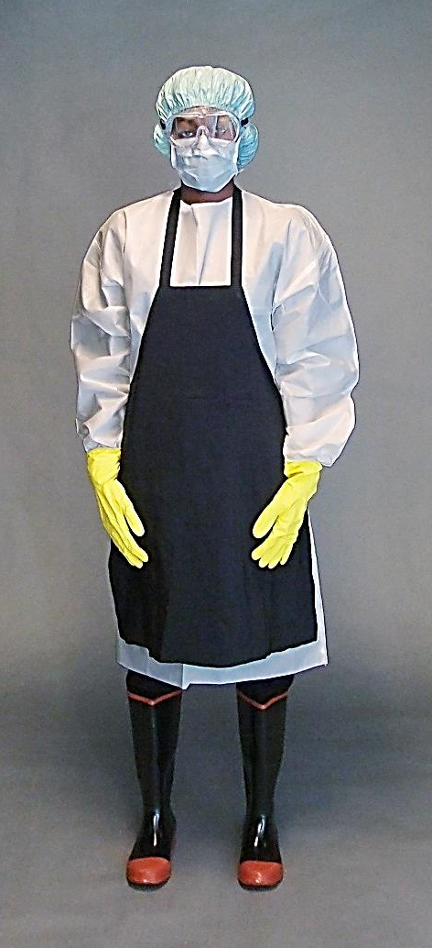
PPE for Ebola or Marburg Environmental Cleaning
Inner gloves (to assist when removing PPE)
Outer gloves (thick, rubber gloves given use of chemicals while cleaning and disinfecting)
Gown or coverall
Apron
Mucous membrane protection (*face mask + face shield) OR (*face mask + goggles)
Rubber boots (or shoe covers)
Head cover
*Respirator can be used in place of face mask (structure of respirator keeps it from collapsing when soaked with sweat; may be preferred in hot, humid climates)
Notes:
Script:
When performing environmental cleaning in the context of Ebola or Marburg, appropriate personal protective equipment, also called PPE, is needed to protect from exposure to infectious agents.
Staff performing environmental cleaning should always wear double gloves – an outer pair of thick, rubber gloves for protection from the chemicals used to clean and disinfect, and an inner pair of gloves to assist when removing PPE. To protect the body, they should wear a gown or coverall and an apron. To protect eyes, nose, and mouth, they should wear a face mask with a face shield or a face mask with goggles. If staff find that face masks collapse from getting soaked with sweat, they can wear a respirator in place of the face mask. The structure of the respirator will prevent this problem and also provide proper protection. Rubber boots or shoe covers and a head cover should also be worn.
You can learn more about PPE from the PPE-focused sessions on the IPC for Ebola or Marburg web page at cdc.gov.

Slide 11
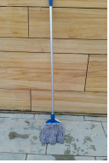
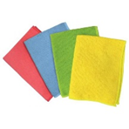
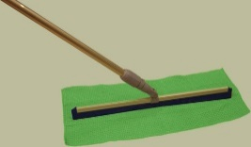
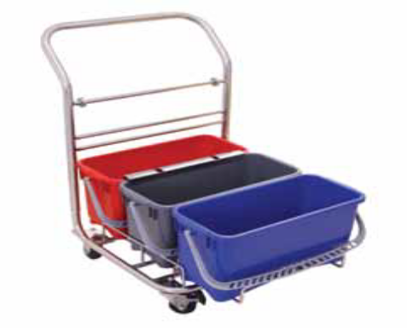
Materials for Environmental Cleaning and Disinfection
Clean water
Soap
Disinfectant (e.g., Jik, HTH)
  0.5% chlorine solution
Small buckets/containers (for surfaces)
Buckets / trolley (for floors)
Cleaning cloths
Squeegees with handles or mops
Notes:
Script:
Materials that your facility will need to have on hand for environmental cleaning and disinfection include clean water, soap, and disinfectant such as Jik or HTH. You’ll need a 0.5% chlorine solution. You’ll also need
small buckets or containers for surfaces and buckets or trolleys for floors,
cleaning cloths,
and either squeegees with handles or mops.

Slide 12
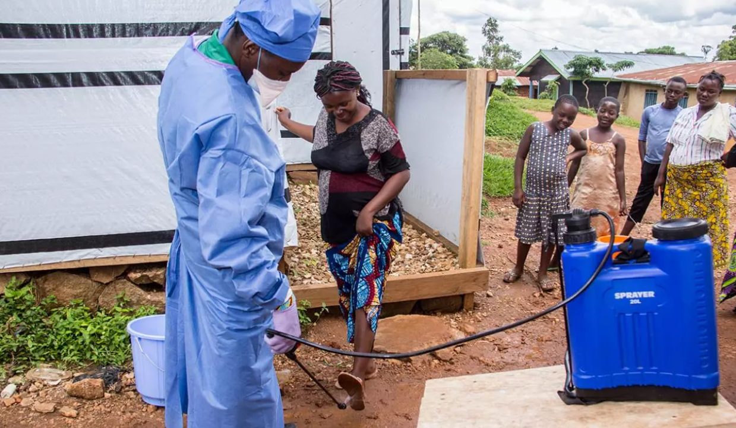
Using Chlorinated Solutions
Use chlorine solution for environmental cleaning in Ebola or Marburg isolation areas
  0.5%*for hard/non-porous surfaces (floors, counters, bed rails)
  Make sure it stays wet on the surface for 10 minutes
Do NOT spray chlorine
  Never spray people
  For surfaces, wiping is preferred
https://www.mercycorps.org/blog/Marburg-outbreaks-africa-guide/chapter-3
* Alternatives: Alcohol at 70-90% (ethanol, isopropyl), improved hydrogen peroxide ≥ 0.5%
Notes:
Script:
When using chlorine solutions for environmental cleaning in Ebola or Marburg isolation areas, a concentration of 0.5%, sometimes called “strong chlorine”, is needed for hard surfaces such as floors, counters, and bed rails. The contact time of chlorine is 10 minutes. This is how long chlorine needs to be on a surface to kill the microorganisms. The surface should be sufficiently wet for 10 minutes to make sure there is enough time to disinfect.
Note that WHO suggests that soiled linens be safely disposed of as infectious waste using incineration (as opposed to disinfection or decontamination).
Chlorine should never be sprayed, especially on people. This includes direct spraying, disinfectant tunnels, or any other “creative” solutions because of potential adverse health effects which we’ll discuss on another slide. When cleaning surfaces with chlorine, wiping is preferred over spraying.
Further reading:
Deliberate exposure of humans to chlorine-the aftermath of Ebola in West Africa - PubMed (nih.gov)

Slide 13
Ensuring Chlorine Potency
Chlorine loses potency:
  Over time
  When exposed to sunlight
  When mixed with organic matter
To ensure potency:
  Make fresh every day
  Keep in closed buckets away from sunlight
  Use only after cleaning with soap and water
  Avoid dipping dirty cloths into a bucket of chlorine
Notes:
Script:
The power of chlorine to disinfect is reduced over time, when exposed to sunlight, or when mixed with organic matter, so it needs to be made fresh everyday and stored in closed buckets away from sunlight. Remember that before disinfecting with chlorine, items should be cleaned with soap and water first to remove organic material from surfaces. Dirty cloths shouldn’t be dipped into chlorine buckets.

Slide 14
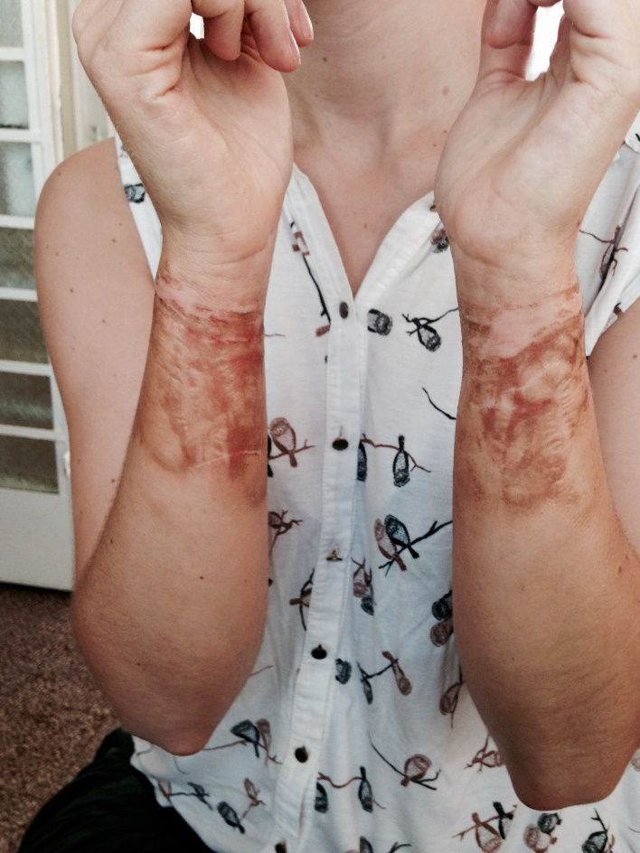
Chlorine—A Word of Caution
Adverse health effects
  Respiratory problems
  Burns
Potentially explosive when mixed
  Calcium hypochlorite + sodium dichloroisocyanurate = potential explosion
Potential for creating toxic gases when mixed with ammonia or other cleaning products
  Eye, nose, and throat irritation and other severe reactions
Chlorine burn from dunking hands with gloves on in bucket –unknown concentration in bucket (Sierra Leone 2014 Ebola Virus Disease outbreak)
Notes:
Script:
Chlorine can cause adverse health effects including respiratory problems and burns when handled without the proper PPE. This picture shows a chlorine burn from dunking hands in a bucket of chlorine. The concentration was unknown, and by the time this person could get the rest of her PPE off safely, about 10 minutes, she had chlorine burns on her arms.
Chlorine is also potentially explosive. Calcium hypochlorite may be combustible when mixed with some other types of powdered chlorine. At an Ebola treatment unit during an Ebola outbreak in West Africa, an explosion happened in a chlorine mixing area, which had two separate types of chlorine present: HTH Granular (Calcium Hypochlorite) and SDIC Powder (Sodium Dichloroisocyanurate). The blast was strong enough to be heard several hundred meters away, scattered chlorine powder around a wide area, and blew out a nearby tarpaulin wall.
Finally, if chlorine is mixed with any other disinfectants or cleaning products, particularly acids and ammonia-based products, there is the potential for the creation of toxic gases, which can cause eye, nose, and throat irritation and other severe reactions.
In sum, always use caution when using chlorine.

Slide 15
Managing Environmental Cleaning Activities
Notes:
Script:
Now let’s talk about managing environmental cleaning activities.

Slide 16
Cleaning Schedules or Logs
Job aids can help guide the daily workflow for cleaning staff and ultimately become records.
They specify the:
  Location (i.e., room, ward)
  Cleaning session (e.g., terminal cleaning)
  Date
  Name/signature of cleaning staff
General Medicine | Daily Cleaning | Date | Staff Name / Signature
Patient Room 1 |  | 17 /11 /22 | Fill in name here
Patient Room 2
Patient Room 3
Patient Toilet | Shift 1: Shift 2:
Notes:
Script:
Job aids can help guide the daily workflow for cleaning staff and ultimately become records. They should specify the location cleaned, such as the room or ward; the cleaning session, for example, terminal cleaning; the date; and the name and signature of the cleaning staff.

Slide 17
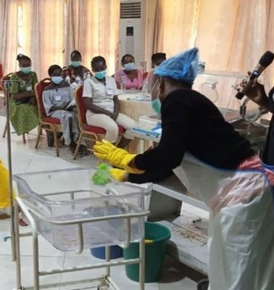
Training for Environmental Cleaning Staff
Staff should be trained before working independently and refresher trainings should be given as needed (e.g., every 6-months)
Training should be:
  Participatory
  Practical (hands-on, demonstration, practice)
  At an appropriate literacy level
  Led by experienced trainers
Notes:
Script:
Staff should be trained before working independently, and refresher trainings should be given as needed (such as every six months). Training should be participatory; practical with hands-on learning, demonstrations, and practice; at an appropriate literacy level for the audience; and led by experienced trainers.

Slide 18
Reflection
Based on what we’ve discussed today, what are three things that could be changed at your facility related to environmental cleaning that would help to better protect cleaning staff and others in your facility from Ebola or Marburg?
Consider things such as environmental cleaning principles, PPE needed, appropriate use of chlorine, and staff training.
Notes:
Reflection:
Encourages participants to apply, analyze, and/or evaluate what they have learned, which helps them to deepen their understanding of the topic
Allows participants to think about how they’re new learning applies to their previous knowledge or experiences, which helps them better understand and remember the ideas taught
Allows you to check participants’ comprehension of what has been discussed to see if any topics need to be reviewed
Script:
Now that we’ve discussed environmental cleaning in the context of Ebola or Marburg in general, I’d like to allow you some time to think about how this applies to your facility specifically. Based on what we’ve discussed today, what are three things that could be changed at your facility related to environmental cleaning that would help to better protect cleaning staff and others in your facility from Ebola or Marburg? Consider things such as environmental cleaning principles, PPE needed, appropriate use of chlorine, and staff training.
Take a minute to write down or think about the three things (or more!) that you might do differently based on what you learned today.
[Give participants 1-2 minutes to write down their ideas. After participants are finished, you may ask for volunteers to share their answers, but as this is a personal question, and some might feel embarrassed about what they feel has not been done properly in the past, don’t require anyone to answer in front of the group.]

Slide 19
Key Takeaways
Environmental cleaning helps prevent the spread of Ebola or Marburg and helps protect you, your co-workers and patients, and your community.
Cleaning with soap and water should always happen before disinfection with chlorine.
Chlorine should never be sprayed on people.
Staff training and cleaning logs can help manage environmental cleaning activities.
Notes:
Script:
To wrap up, there are several key ideas that I hope you take away from this session:
First, remember that environmental cleaning is crucial for preventing the spread of Ebola or Marburg. It protects you and your co-workers and patients. By protecting yourself, you also protect your friends, family, and others in your community.
Remember that environmental cleaning involves cleaning and disinfection. Cleaning with soap and water should always happen before disinfection with chlorine.
Chlorine should never be sprayed on people.
And finally, staff training and cleaning logs can help manage environmental cleaning activities.

Slide 20
Thank you!

