Slide 1
Infection Prevention and Control (IPC) for Ebola or Marburg:
Creating an Isolation Area in Your Facility
Healthcare Settings with Limited to Intermediate Resources
Updated: June 2026
Notes:
Intended Audience: This presentation focuses on what facilities management personnel need to know to prevent Ebola disease (Ebola) or Marburg virus disease (Marburg), from entering healthcare facilities. See the CDC web page https://www.cdc.gov/vhf/marburg/non-us/global-ipc.html for details on what healthcare workers should know to assist the process of identifying and isolating suspect Ebola or Marburg cases.
Please note that the topics for IPC for Ebola or Marburg training are published in sequence, with the expectation that participants will progress through the series. You may, however, mix and match content to meet participant needs, and you may need to adjust the sample script below accordingly.
Estimated time with audience participation: Approximately 20-25 minutes
Script:
Welcome! Today we’ll continue focusing on key strategies to protect you, your patients and co-workers, and your friends and family from Ebola disease – or Ebola – and Marburg virus disease - or Marburg. The key strategy we’ll focus on today is isolation and how to prepare isolation areas for people arriving to health facilities who might have Ebola or Marburg.

Slide 2
Learning Objectives
After this presentation, participants will be able to
  Explain why isolating patients with suspected Ebola or Marburg is important
  Describe at least 3 best practices for setting up a short-term isolation area for patients with suspected Ebola or Marburg
Notes:
Script:
We have two learning objectives for today. By the end of this session, you should be able to explain why isolating people suspected of having Ebola or Marburg is important and describe at least 3 best practices for setting up a short-term isolation area for patients with suspected Ebola or Marburg.

Slide 3
Discuss
Why is it important to keep people who might have Ebola or Marburg isolated from other patients in a healthcare facility?
Notes:
Activating background knowledge:
A key benefit of working with adult learners is that they likely already have some knowledge or experience related to the topic you are teaching. Activating background knowledge helps participants connect new learning to what they already know and may help them understand and remember new information better. It also helps you, the instructor, to identify gaps in knowledge where you may need to spend extra time or add emphasis while teaching. Use this slide as an opportunity to let participants share what they already know.
Script:
Let’s start with a question. Why is it important to keep people who are suspected of having Ebola or Marburg isolated from other patients in a healthcare facility?
[Allow participants 2 minutes to discuss as a large group or in small groups. If it doesn’t come up in discussion, add the following.]

Slide 4
Early identification and separation of patients with suspected Ebola or Marburg prevents bringing unrecognized Ebola or Marburg into your healthcare setting.
This protects…
YOU
Your co-workers & patients
Your community
Notes:
[Based on participant answers for the last slide, you may wish to adapt this script.]
Script:
As we discussed when talking about screening in the context of Ebola or Marburg, if a person with an undiagnosed Ebola or Marburg were to be allowed into a healthcare facility, they could spread the virus to patients nearby and to the staff that cares for them. Early identification and separation of patient with suspected Ebola or Marburg prevents bringing unrecognized Ebola or Marburg into the healthcare setting, which protects you and the co-workers and patients at your facility. By keeping yourself healthy, you also avoid spreading illness to your family and friends. So, keeping patients with suspected Ebola or Marburg separate in a healthcare facility protects you, your co-workers and patients, and your community.”
In the last session, we focused on setting up a screening area for identification of people potentially ill with Ebola or Marburg before they enter the healthcare facility. This session, we’ll focus on setting up an isolation area – a place where people identified as potentially being ill with Ebola or Marburg can wait, away from others, for temporary care and then transport to a facility designed to treat people with Ebola or Marburg.

Slide 5
Setting Up an Isolation Area
Notes:
Script:
Let’s first talk more about what isolation is. Then, we’ll discuss how to set up an isolation area.

Slide 6
Isolation
When a suspected Ebola or Marburg patient is identified, the patient should be isolated to prevent spreading the illness to others.
Every facility should have space identified that can function as isolation until the patient can be transferred to a designated facility for testing and care.
Notes:
Script:
If, through the screening process, someone is identified as potentially having Ebola or Marburg, they should immediately be separated from other patients and from healthcare workers. This separation is called isolation. Isolation prevents the person from spreading Ebola or Marburg to people near them including you, other healthcare workers, or patients.
Every facility should have space identified that can function as isolation until the patient can be transferred to a designated facility for testing and care. Sometimes this is called a “holding area” or “temporary isolation.”

Slide 7
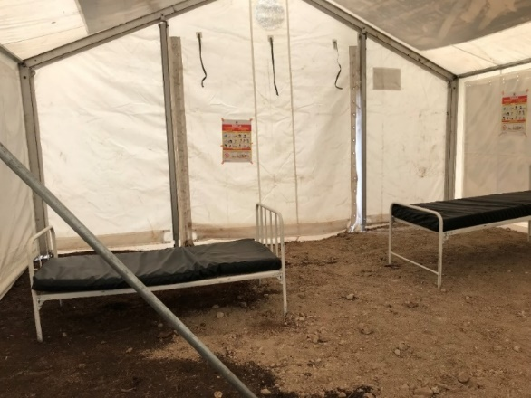
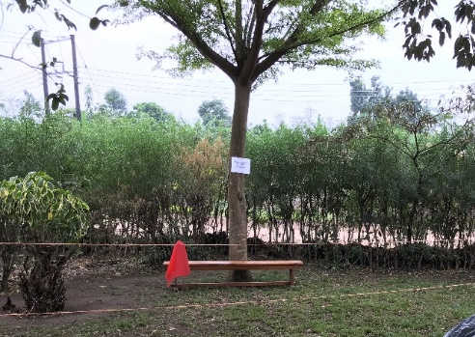
Isolation Area Requirements
Separate from other patient care areas, such as:
  Separate building
  Temporary structure/tent
  Demarcated area (under a tree)
Designated for use only as Ebola or Marburg isolation
  Should not be dual purpose
Restricted access
  Fencing, taped off, etc.
  Only healthcare workers should enter isolation (to give oral medicines, etc.)
Notes:
Script:
Isolation areas must be separate from other patient care areas to prevent sick people from passing their illness to others. This could mean a separate building, but based on your facility design and resources, it could also be a temporary structure such as a tent as seen in the top picture here or an area outside that is marked off for people in isolation, such as under a tree, which we see in the bottom photo.
The isolation area should be designated for use only by people suspected of having Ebola or Marburg. If some patients will need to be isolated for other reasons, there needs to be a different isolation area for them.
The isolation area should also have restricted access so that only healthcare workers, such as to provide oral medicines. You may need to fence or tape off areas or entryways to restrict access.

Slide 8
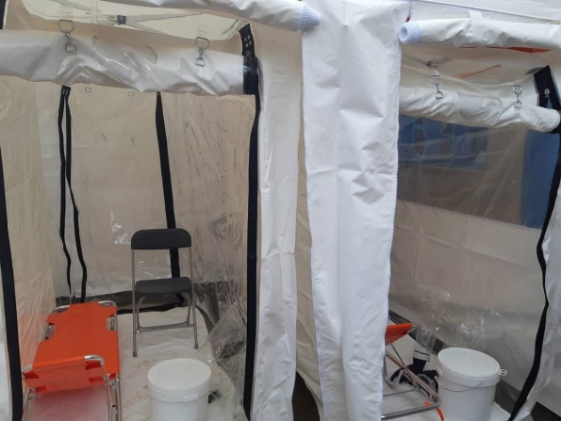
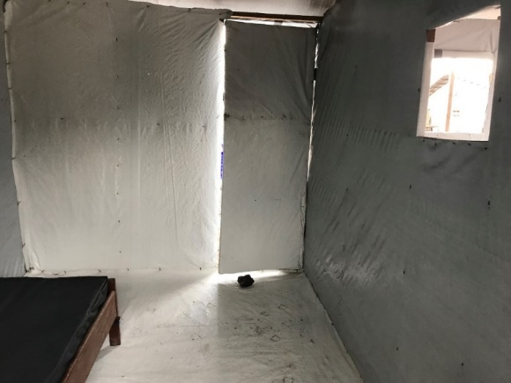
Isolation Area Design
Unidirectional flow
  Ideally, separate entrance and exit
  Dedicated spaces for putting on and removing PPE
  Separate patient care supplies
Appropriate spacing
  At least one meter between beds
Supplies to hold patients temporarily and safely
  Separate toileting options for each patient (e.g., latrine or commode bucket)
  Hand hygiene stations
Notes:
Script:
The isolation area should be designed with unidirectional flow. That means that people should only move through the space in one direction like a one-way street. Ideally, your isolation area will have a separate entrance and exit, dedicated spaces for putting on and removing personal protective equipment, also called PPE, and separate patient care supplies to help ensure unidirectional flow.
The isolation area should also have at least one meter between beds. Just because a patient is in an isolation unit doesn’t mean they have Ebola or Marburg, although some patients might. Keeping appropriate spacing between patients helps protect uninfected patients from becoming infected.
Finally, the isolation area should be designed to hold patients temporarily and safely. This means that hand hygiene stations must be available, and separate toileting options for each patient such as a latrine or commode bucket are required.
Both of these pictures show examples of isolation areas. You can see in the picture at the top that the isolation area has a bed and a chair for the patient and that there is a dedicated toileting option for each patient. And that brings us to our next slide on the equipment and supplies that should be in the isolation area.

Slide 9
Isolation Area Equipment & Supplies
Patient care
(IF REQUIRED)
Cleaning and disinfection
Waste
For patients
  Chairs, or bench if no chairs available
  Food and water
  Hand hygiene station
  Separate toilet or latrine
  PPE for healthcare workers
  Hand hygiene stations for healthcare workers
  Designated patient care equipment
  0.5% chlorine solution (for disinfection) or other approved hospital disinfectant*
  Soap and water
  Cleaning equipment (buckets, cloths, mop)
  Biohazard waste bin (red)
  General waste bin
* Alcohol at 70-90% (ethanol, isopropyl), improved hydrogen peroxide ≥ 0.5%
Notes:
Script:
A lot of equipment and supplies are necessary both in the isolation area and the areas where people will put on and take off personal protective equipment or PPE.
Every isolation area should have the following available for patients:
A chair or bench for each patient and/or a bed with a plastic-covered mattress
Food and water
A hand hygiene station
And a toileting option dedicated to each isolated patient such as a toilet, latrine, or bedpan
If the area will be used for patient care, it should also have
PPE for healthcare workers
And designated patient care equipment.
For cleaning and disinfection, the isolation area should have
0.5% chlorine solution or some other disinfectant
Soap and water
And designated cleaning equipment for the isolation unit such as mops, buckets, and cleaning cloths
For waste disposal there should be
A biohazard waste bin
And a general waste bin

Slide 10
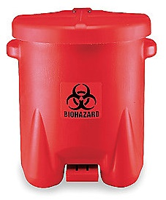
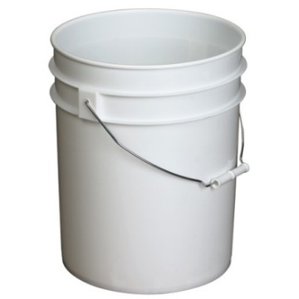
PPE Removal Area Equipment & Supplies
The PPE removal area should have:
  Bucket of strong (0.5%) chlorine solution (for non-porous items, such as boots, goggles)
  Bucket of mild (0.05%) chlorine solution (for porous items, such as cloth gowns)
  Container with a lid for infectious waste
  Container for reusable PPE
  Hand hygiene supplies
Biohazard waste bin
(can be yellow or red)
Bucket for dirty, reusable PPE to be reprocessed
Notes:
Script:
Ideally, the isolation area will have a separate space for putting on and taking off PPE.
The area for putting on PPE should have a hand hygiene station and a supply of clean PPE.
The PPE removal area should be supplied with these things to allow safe removal of PPE:
A bucket of strong (.5%) chlorine solution
A bucket of mild (.05%) chlorine solution
A container with a lid for biohazard waste such as disposable PPE and other infectious waste
A container for reusable PPE that will be reprocessed
And hand hygiene supplies
We will talk more in another session about how to clean and disinfect PPE so that it can be re-used. If you would like to review how to put on and take off PPE, you can check out the slides from the session focused on that topic.

Slide 11
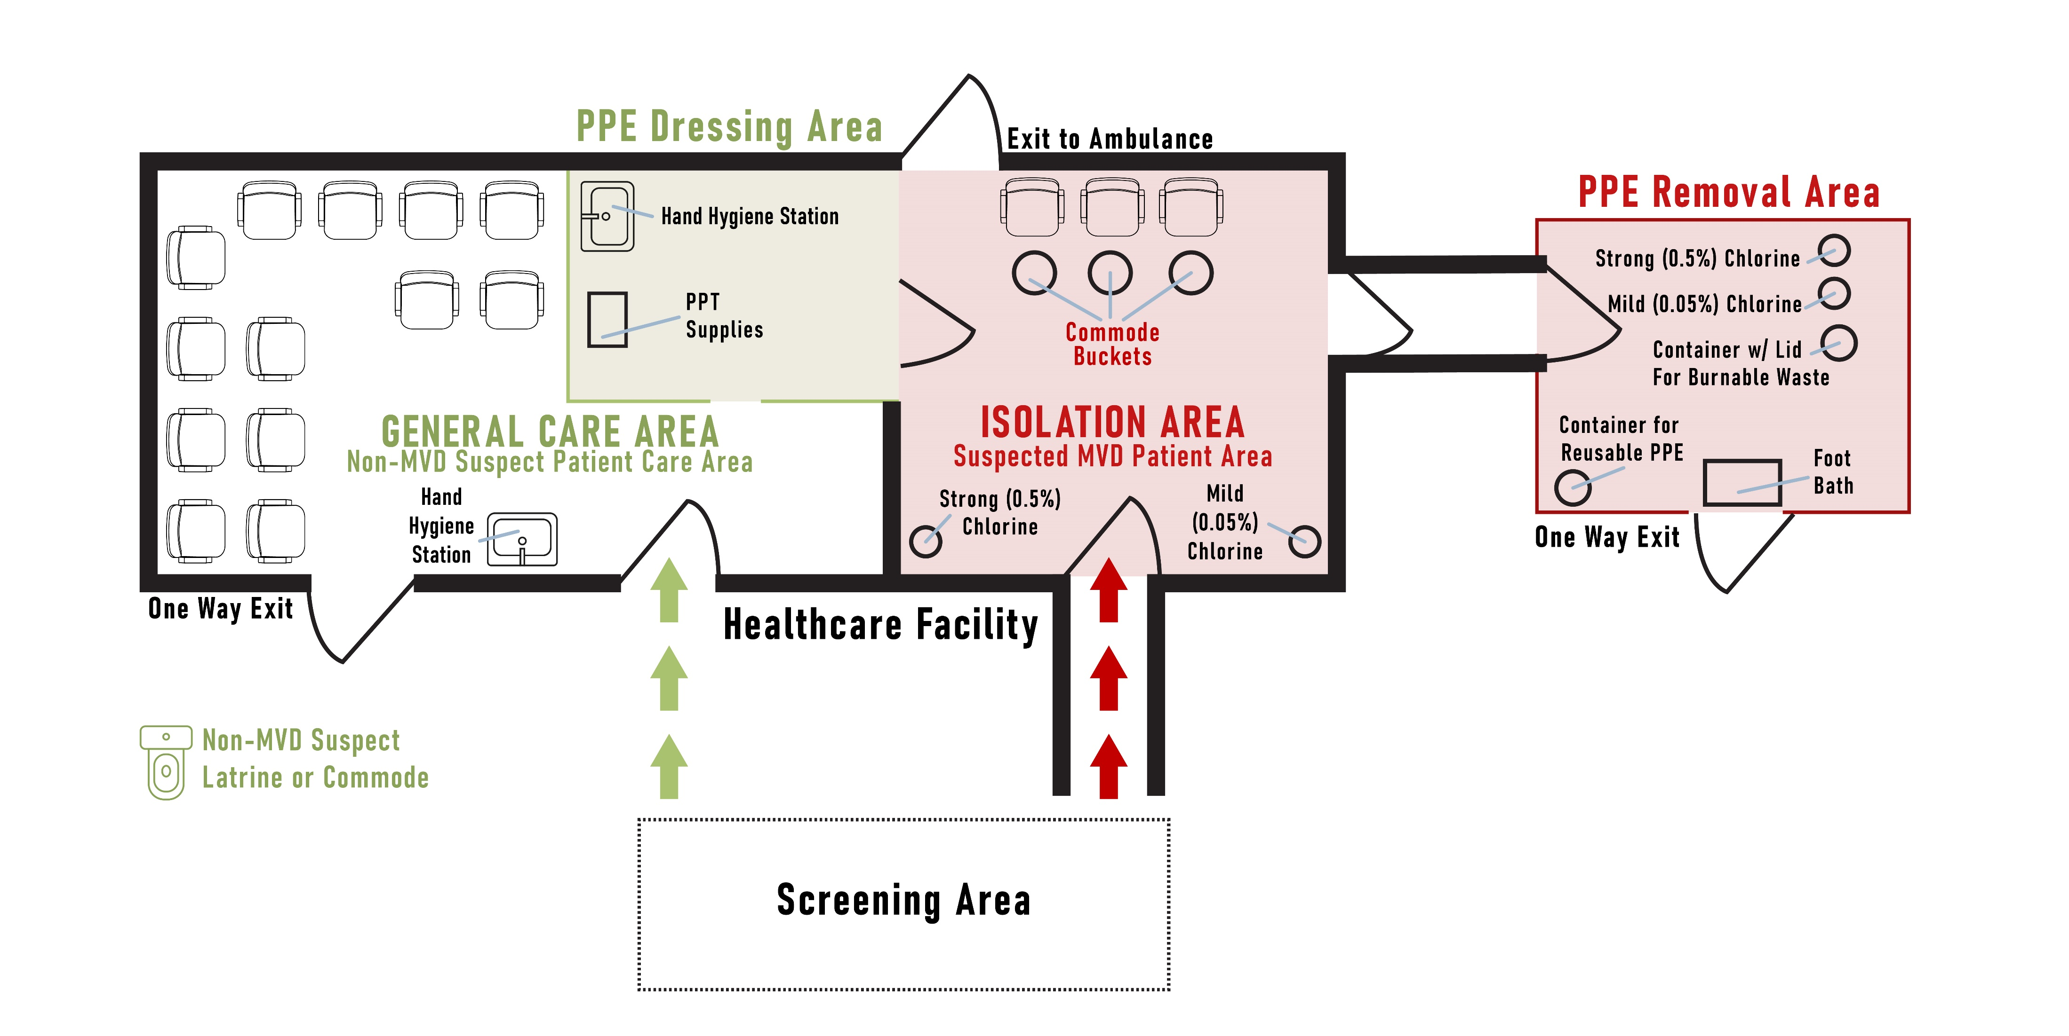
Example Facility Setup
Notes:
Script:
Let’s return to our example from the last session of what facility setup could look like. Again, this image is specific to Marburg but is applicable for Ebola, too. Remember that, just like the screening area, your isolation area may look different from this facility because it will be tailored to the design of your facility and the available resources.
Notice that anyone who is suspected of having Ebola or Marburg after screening is sent directly to the isolation area.
Notice that the isolation area has separate entries and exits for patients and staff, which allow for unidirectional flow of traffic through the space.
Notice also that there is a place for healthcare workers to put on PPE and a separate place for them to take it off. The positioning of these areas also encourages unidirectional flow and ensures that clean PPE is kept separate from used PPE.
Notice that the PPE dressing area has a hand hygiene station and clean PPE supplies. The removal area contains supplies needed for safe removal of soiled PPE including chlorine solutions, a footbath, a container with a lid for burnable waste, and a container for reusable PPE.
Notice that the isolation area has room for appropriate spacing between beds and that each patient would have their own toileting option – in this case, a commode bucket. There are also chlorine stations in the room.

Slide 12
Reflection
How is the isolation area for Ebola or Marburg different from other isolation areas you might have had to set up in the past?
What challenges has your facility had in the past with setting up isolation areas?
If you have never had to participate in setting up an isolation area, what challenges do you imagine your facility might have?
Notes:
Reflection:
Encourages participants to apply, analyze, and/or evaluate what they have learned, which helps them to deepen their understanding of the topic
Allows participants to think about how they’re new learning applies to their previous knowledge or experiences, which helps them better understand and remember the ideas taught
Allows you to check participants’ comprehension of what has been discussed to see if any topics need to be reviewed
Script:
Now that you’re familiar with how to set up an isolation area for Ebola or Marburg in a healthcare facility, let’s think about how this might work specifically in your facility.
If you’ve ever needed to isolate people at your facility, how is the isolation area setup for Ebola or Marburg similar to or different from other isolation areas your facility has set up in the past (for example, COVID-19)?
[Give participants a few minutes to discuss in small groups or as a large group.]
What challenges has your facility encountered in the past with creating isolation areas? If you haven’t experienced this before, what challenges do you imagine your facility might have?
[List challenges as participants mention them. Then, ask the group to offer suggestions for ways they might overcome those challenges. Answers will vary. You may also offer suggestions as you see fit. Recommended time for this discussion is 7-10 minutes. You may choose to keep this conversation shorter due to time constraints or to extend it if time allows.]

Slide 13
Key Takeaways
Isolation prevents people sick with Ebola or Marburg from spreading the illness to others. It protects you, your co-workers and patients, and your community.
Every facility should have a separate isolation area for patients with suspected Ebola or Marburg until they can be transferred to a designated facility for testing and care.
Notes:
Script:
To wrap up today’s session, let’s review some key points. First, isolation prevents people sick with Ebola or Marburg from spreading the illness to others. It protects you, your co-workers and patients, and your community, and, in fact, it is one of the most important things you can do at your healthcare facility to protect yourself and your community from Ebola or Marburg.
Every facility should have a separate isolation area for patients with suspected Ebola or Marburg until they can be transferred to a designated facility for testing and care.

Slide 14
Thank you!

