Slide 1
Infection Prevention and Control (IPC) for Ebola or Marburg :
Preparing Your Facility for Identification of Potential Ebola or Marburg patients
Healthcare Settings with Limited to Intermediate Resources
Updated: June 2026
Notes:
Intended Audience: This presentation focuses on what facilities management personnel need to know to prevent Ebola disease (Ebola) or Marburg virus disease (Marburg), from entering healthcare facilities. See the IPC for Ebola and Marburg web page on cdc.gov for details about what healthcare workers should know to assist the process of identifying and isolating suspect Ebola or Marburg cases.
Please note that the topics for IPC for Ebola or Marburg training are published in sequence, with the expectation that participants will progress through the series. You may, however, mix and match content to meet participant needs, and you may need to adjust the sample script below accordingly.
Estimated time with audience participation: Approximately 20-25 minutes
Script:
Welcome! Today we'll be focusing on how to prepare your facility to identify, or screen, for potential patients with Ebola disease – or Ebola - and Marburg virus disease – or Marburg. Screening is a key strategy for preventing Ebola or Marburg from entering your healthcare facility and is crucial to help protect you, others in your facility, and your friends and family from Ebola or Marburg.

Slide 2
Learning Objectives
After this presentation, participants will be able to
  Explain why screening for Ebola or Marburg is important
  Describe best practices for setting up an Ebola or Marburg screening area
Notes:
Script:
We have two learning objectives for today. By the end of this session, you should be able to explain why screening for Ebola or Marburg is important for everyone entering your facility and describe best practices for setting up a screening area to identify patients who might have Ebola or Marburg.

Slide 3
Discuss
Why is it important to keep people who are suspected of having Ebola or Marburg separate from other patients in a healthcare facility?
Notes:
Activating background knowledge:
A key benefit of working with adult learners is that they likely already have some knowledge or experience related to the topic you are teaching. Activating background knowledge helps participants connect new learning to what they already know and may help them understand and remember new information better. It also helps you, the instructor, to identify gaps in knowledge where you may need to spend extra time or add emphasis while teaching. Use this slide as an opportunity to let participants share what they already know.
Script:
Let’s start with a question. Why is it important to keep people who are suspected of having Ebola or Marburg separate from other patients in a healthcare facility?
[Allow participants 2-3 minutes to discuss as a large group or in small groups.]

Slide 4
Early identification and separation of patients with suspected Ebola or Marburg prevents bringing unrecognized Ebola or Marburg into your healthcare setting.
This protects…
YOU
Your co-workers & patients
Your community
Notes:
[You may wish to adapt the script for this slide based on what participants said to answer the question on the previous slide.]
Script:
If a person with undiagnosed Ebola or Marburg were to be allowed into a healthcare facility, they could spread Ebola or Marburg to patients nearby and to the staff that cares for them. Early identification and separation of patients with suspected Ebola or Marburg prevents bringing unrecognized Ebola or Marburg into the healthcare setting, which protects you, your co-workers, and your patients. By keeping yourself healthy, you also avoid spreading illness to your family and friends. So, keeping patients with suspected Ebola or Marburg separate in a healthcare facility helps protect you, your co-workers and patients, and your community.

Slide 5
Key Strategies to Prevent Introduction of Ebola or Marburg in Health Facilities:
Identify
Isolate
Inform
Notes:
Script:
There are 3 key strategies to prevent the introduction of Ebola or Marburg in healthcare facilities:
Identifying people who might be ill with Ebola or Marburg before they enter the facility.
Isolating patients with suspected Ebola or Marburg from others.
And informing the necessary authorities at your facility.
These things are the most important things you can do at your healthcare facility to help protect yourself and your community
Today, we’ll focus on how facilities can prepare for the first strategy here: identifying people who might be ill with Ebola or Marburg.

Slide 6
Setting Up a Screening Area
Notes:
Script:
First, we’ll talk about what screening is exactly, and then we’ll get into the details of setting up a screening area.

Slide 7
Identify
Screening is the process of evaluating whether a patient meets a standardized case definition.
Screening involves 2 parts:
Temperature check
Questionnaire of signs, symptoms, and risk factors
Notes:
Script:
Screening is the process of evaluating whether a patient meets a standardized case definition. Screening is like a sorting process. It operates like a sieve, separating the people who probably have a condition from those who probably do not. Screening allows patients suspected of having Ebola or Marburg to be promptly isolated and referred for testing and care at a facility intended for that purpose.
In areas with Ebola or Marburg transmission, screening involves looking for Ebola or Marburg symptoms and determining risk factors early in the care process. It can be done with a non-contact thermometer and a questionnaire.

Slide 8
Key Points for Screening for Ebola or Marburg
Screening should take place at the point of entry of a healthcare facility.
The screening area should be set up so that all people can be screened prior to entering
  This includes patients, healthcare workers, and accompanying family members
Notes:
Script:
When creating a screening area in your facility, keep in mind that screening should take place at the point of entry of your healthcare facility, and all people will need to be screened including patients, healthcare workers, and family members that accompany patients. If your facility has multiple entrances, you may need to close some entrances so that people can only enter where they will be screened.

Slide 9
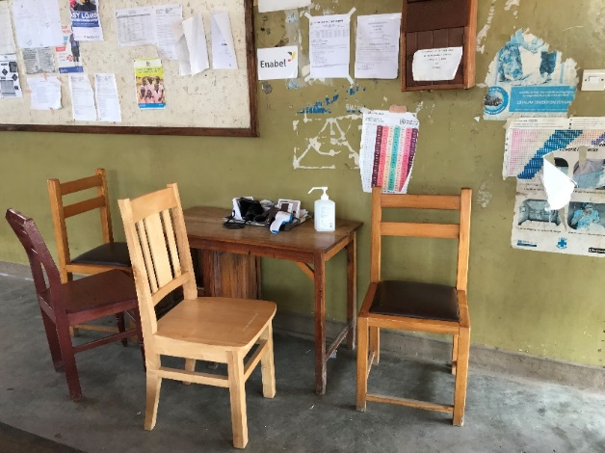
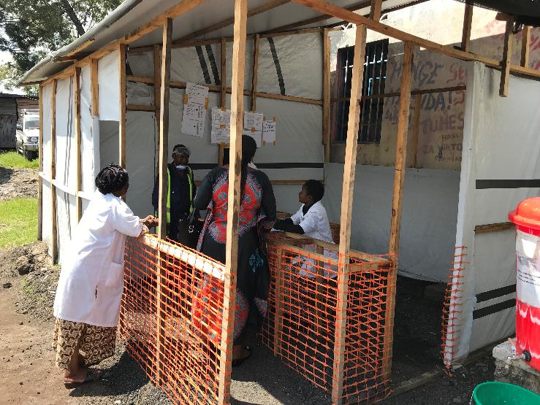
Creating a Screening Area
Tailor the screening area to facility design and resources.
  Construction of infrastructure is not required
  May be as simple as two chairs separated by a table
At least 1 meter distance maintained (except during temperature check) based on WHO recommendations
Notes:
Script:
The screening area should be tailored to the facility design and resources available. This means screening areas may look different at different facilities. Creating a screening area can be simple. It does NOT require the construction of infrastructure. It can be just two chairs separated by a table as long as there is room for the screener to keep at least 1 meter’s distance (about an arm’s length) from the person being screened.
The pictures on this slide show two examples of what a screening area might look like. The first shows an area constructed specifically for screening while the second shows chairs separated by a table at the entry of a facility. While these screening areas are very different, both can function equally well for screening patients.
Having a screening area for everyone who enters your facility is crucial. However, the process of screening effectively and using appropriate precautions is more important than the place where screening occurs.

Slide 10


Screening Area Setup
For screener safety, screeners should be able to:
Maintain a distance (at least 1 meter per WHO recommendation – about arm’s length) from the person being screened.
Avoid direct face-to-face interaction
  If possible, place plexiglass between screener and person being screened
  Angle any chairs away from each other
Set chairs at angles to avoid being face-to-face. Keeping a table between chairs helps maintain proper distance.
Notes:
Script:
As mentioned in the previous slide, per recommendation of the World Health Organization, for safety during screening activities, healthcare workers should be able to maintain a distance of at least 1 meter between themselves and the person being screened. If the facility cannot be arranged so that this distance can be maintained, healthcare workers will need to wear personal protective equipment, or PPE, while screening.
For healthcare worker protection, direct face-to-face interaction with people being screened should also be avoided to protect mucous membranes – eyes, nose, and mouth. Your facility may place plexiglass at the screening station between the screener and the person being screened. If that is not an option at your facility, angling chairs away from each other, as seen in this image, is a simple and effective way to achieve this.

Slide 11
Screening Area Supplies
The screening area should have:
Hand hygiene station with liquid soap for handwashing (alternative is alcohol-based hand rub) with paper or cloth towels
Waste bins: a general (non-biohazard) waste bin
Notes:
Script:
People who are screening will need to perform hand hygiene often, so every screening area should have a hand hygiene station with soap and water for handwashing and paper or cloth towels to dry hands or, as an alternative, alcohol-based hand rub.
The screening area should also have a waste bin for general, non-biohazard waste.

Slide 12
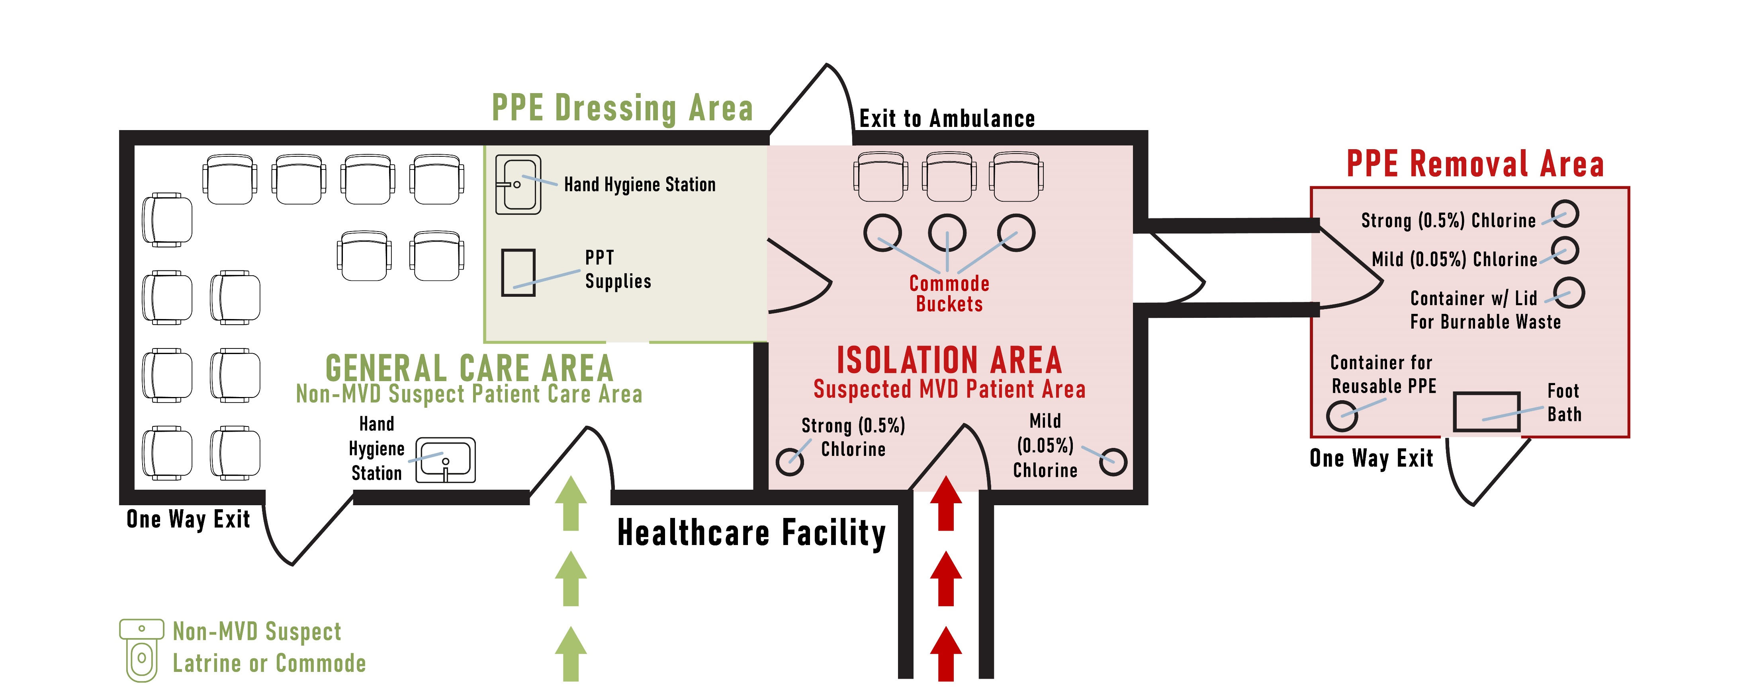
Example Facility Setup
Screening Area
Screening Station
Hand Hygiene Stations
Notes:
Script:
This is one example of what facility setup could look like. This image is specific to Marburg but is applicable to Ebola also. Let’s focus right now on the screening area in the bottom right corner. Remember that your screening area may look different from this one because it will be tailored to the design of your facility and the available resources.
Notice that the only entry to this facility is through the screening area, so everyone that enters can be screened.
Notice that the person screening can be separated from the person being screened with a table so that they can maintain proper space.
Also notice the hand hygiene station.
Finally, notice that once screened, people who pass the screening may proceed to the general care area while those suspected of having Ebola or Marburg are sent directly to a separate isolation area.
If, like in this facility, people need to go outside to get from the screening area to the general care area, you may need to mark off this area with fencing or tape to keep out people who have not yet been screened.
We will talk more in our next session about setting up an isolation area at your facility.

Slide 13
Reflection
How is the screening area for Ebola or Marburg different from other screening areas you might have had to set up in the past?
What challenges have you encountered in the past with creating screening areas? Or, if you have never had to do this before, what challenges do you anticipate encountering?
Notes:
Reflection:
Encourages participants to apply, analyze, and/or evaluate what they have learned, which helps them to deepen their understanding of the topic
Allows participants to think about how they’re new learning applies to their previous knowledge or experiences, which helps them better understand and remember the ideas taught
Allows you to check participants’ comprehension of what has been discussed to see if any topics need to be reviewed
Script:
Now that you’re familiar with how to set up a screening area for Ebola or Marburg in a healthcare facility, let’s think about how this might work in your facility.
If you’ve ever needed to screen people entering your facility, how is the screening area setup for Ebola or Marburg similar to or different from other screening areas set up in the past (for example, COVID-19)?
[Give participants a few minutes to discuss in small groups or as a large group.]
What challenges has your facility encountered in the past with creating screening areas? If you haven’t experienced this before, what challenges do you imagine the facility might have?
[List challenges as participants mention them. Then, ask the group to offer suggestions for ways they might overcome those challenges. Answers will vary. You may also offer suggestions as you see fit. Recommended time for this discussion is 7-10 minutes. You may choose to keep this conversation short due to time constraints or to extend it if time allows.]

Slide 14
Key Takeaways
Proper screening prevents unrecognized patients with Ebola or Marburg from entering a healthcare facility. This protects you, your patients, and your community.
Screening should take place at the point of entry of a healthcare facility.
The screening area should be set up so that all people are screened prior to entering
Notes:
Script:
To wrap up today’s session, let’s review some key points. First, proper screening is one of the most important things you can do at your healthcare facility to protect yourself and your community. Screening prevents unrecognized patients with Ebola or Marburg from entering a healthcare facility. This protects you, your patients, and your community.
Screening should take place at the point of entry of a healthcare facility.
And the screening area should be set up so that all people are screened prior to entering

Slide 15
Thank you!

