Slide 1
Infection Prevention and Control (IPC) for Ebola or Marburg:
Healthcare Worker and Inpatient Monitoring
Healthcare Settings with Limited to Intermediate Resources
Updated: June 2026
Notes:
Intended Audience: This presentation focuses on what healthcare workers should know about monitoring healthcare workers and inpatients for Ebola disease (Ebola) and Marburg virus disease (Marburg). This session builds on general information about screening for Ebola or Marburg found in Slide Deck 1 for healthcare workers found at the IPC for Ebola or Marburg web page on cdc.gov.
Please note that the topics for IPC for Ebola or Marburg training are published in sequence with the expectation that participants will progress through the series. You may, however, mix and match content to meet participant needs, and in these cases, you will need to adjust the sample script accordingly.
Estimated time with audience participation: 15 minutes
Script:
Welcome! Today we'll be focusing on monitoring healthcare workers and inpatients in your facility for Ebola disease – or Ebola – and Marburg virus disease – or Marburg. We’re going to talk about why this monitoring is important for your safety and the safety of those around you, and then we’ll discuss the general process for these types of monitoring.

Slide 2
Learning Objectives
After this presentation, participants will be able to
  Explain why healthcare worker monitoring is important in the context of Ebola or Marburg.
  Explain why inpatient monitoring is important in the context of Ebola or Marburg.
  Describe steps for monitoring inpatients.
Notes:
Script:
We have three learning objectives for today. By the end of our time together today, you should be able to explain why healthcare worker monitoring and inpatient monitoring is important in the context of Ebola or Marburg. You should also be able to describe steps for monitoring inpatients.

Slide 3
Screening for Ebola or Marburg involves 2 parts. What are they?
___________ and _____________
Notes:
Activating background knowledge:
A key benefit of working with adult learners is that they likely already have some knowledge or experience related to the topic you are teaching. Activating background knowledge helps participants connect new learning to what they already know and may help them understand new information better. It also helps you, the instructor, to identify gaps in knowledge where you may need to spend extra time or add emphasis while teaching. Use this slide as an opportunity to let participants share what they already know.
Script:
To get us started, let’s review what you know about screening for Ebola or Marburg. When you screen someone entering your facility for Ebola or Marburg, the process involves two parts. Does anyone know what they are?
[Take answers from 2-3 participants.]

Slide 4
Screening for Ebola or Marburg involves 2 parts:
Temperature check and questionnaire
Notes:
Script:
[As participants may have already stated:]
The two parts are a temperature check and a questionnaire that asks the person being screened about signs, symptoms, and potential risk factors. We’re going to talk in more detail today about using this screening method to monitor healthcare workers and people who might already be checked into your facility for other needs.

Slide 5
Why Monitor Healthcare Workers?
Healthcare workers are at high risk for exposure to Ebola or Marburg.
If they are ill, they can infect co-workers or patients.
Screening healthcare workers regularly helps quickly identify if they are ill, provide early care, and isolate them from others.
This helps protect you, your patients and co-workers, and your community.
Notes:
Script:
Let’s start by talking about monitoring healthcare workers. In a previous session, we talked about the importance of screening anyone who enters your healthcare facility and isolating anyone suspected of having Ebola or Marburg to prevent transmission within the facility. Healthcare workers are no exception. They must be screened, too.
Healthcare workers are exposed to potential risks both within the facility where they work and within the community. They may be exposed to sick patients while at work. While not at work, they may interact with friends and family who are unknowingly ill with Ebola or Marburg, or they may be asked to provide informal care to friends and family who are sick.
If a healthcare worker is sick with Ebola or Marburg and comes to work, they might transmit Ebola or Marburg to their co-workers and/or the patients they treat. Screening healthcare workers before entry into a facility – just as you would screen everyone else – helps to quickly identify if they are ill, refer them for early care, and isolate them from others. This prevents the spread of Ebola or Marburg in your facility and helps protect you, your patients and co-workers, and your community from exposure to Ebola or Marburg.

Slide 6
Healthcare Worker Monitoring
Screen all healthcare workers prior to each shift.
  Temperature check
  Questionnaire: signs and symptoms + risk factors in past 21 days
Encourage reporting symptoms – don’t penalize
  Sick healthcare workers should be evaluated for Ebola or Marburg
Maintain a record of healthcare workers entering isolation areas because of high-risk for potential exposure
Notes:
Script:
The process for screening healthcare workers is the same as screening for anyone else entering your facilities. At the point of entry to the facility, they should have a temperature check and be questioned about the presence of any signs or symptoms and any recent exposures.
Healthcare workers should be encouraged and not penalized for reporting symptoms so that they don’t feel pressured to come to work while experiencing symptoms where they could potentially infect patients and co-workers. Given their high risk of exposure, if a healthcare worker is out sick, they should be quickly evaluated for possible Ebola or Marburg.
Beyond the screening process, healthcare worker monitoring involves keeping a record of healthcare workers entering patient isolation areas because they may be considered more high-risk for potential exposures.

Slide 7
Why Monitor Inpatients?
The incubation period for Ebola and Marburg is
between 2-21 days.
Some patients may be admitted for other reasons and may not have signs or symptoms of Ebola or Marburg upon admission.
They may develop signs and symptoms during their stay in your facility.
Quickly identifying people showing symptoms of Ebola or Marburg and isolating them from others helps protect you, your patients and co-workers, and your community.
Notes:
Script:
In areas of active Ebola or Marburg transmission, monitoring patients who have already been admitted to your facility for other reasons, including delivering a baby or treatment for a different illness, is also important so that you are quickly aware if they develop symptoms. Inpatient identification is an additional layer of screening.
Patients may be an unknown contact of someone sick with Ebola or Marburg or may be a registered contact who has not been followed. The incubation period for Ebola and Marburg is 2-21 days. Because the incubation period can be up to three weeks, some patients that have been exposed might not be having symptoms when they come to a healthcare facility for another need. However, they might develop signs and symptoms during their stay in the facility. Quickly identifying patients showing symptoms of Ebola or Marburg and isolating them from others helps protect you, your patients and co-workers, and your community.

Slide 8
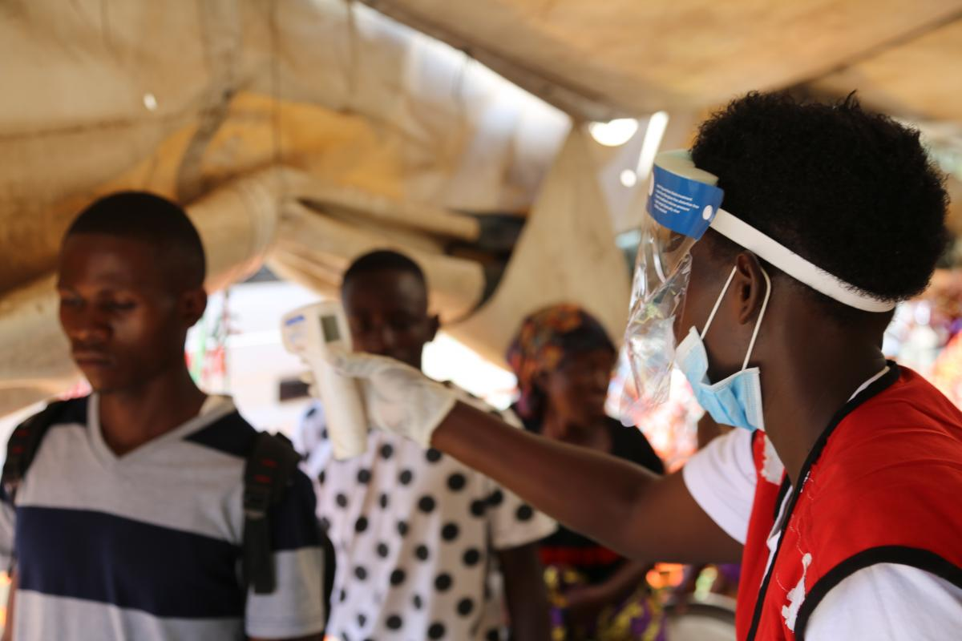
Inpatient Monitoring Process
Apply standard precautions for all patients.
Take temperature at least twice a day for all inpatients
Assess patients for signs and symptoms at least once a day. Assess immediately in the presence of fever (≥38°C).
Complete the Inpatient Monitoring Form
Notes:
Script:
Similar to the screening process that happens at the facility entrance, inpatient monitoring involves a temperature check and an evaluation of signs or symptoms and potential exposures. You should apply standard precautions for all patients while completing the monitoring.
In areas of active Ebola or Marburg transmission, temperatures should be checked twice a day for all inpatients and assessments should be completed at least once a day using the inpatient monitoring form. All information from monitoring should be recorded in the inpatient monitoring form.
If, while screening, you find that a patient’s temperature is 38 degrees Celsius or higher, that person should be assessed immediately for signs, symptoms, and potential exposure to Ebola or Marburg so that they can be quickly isolated if necessary.
The exact process for this will look different in different facilities based on human resources available and facility policies.

Slide 9
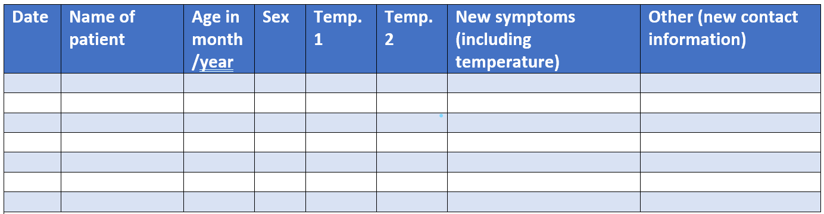
Inpatient Monitoring Form
Temperature – 2 times/day
Signs and symptoms – 1 time/day
Optional: Exposures in the last 21 days
  This may be asked to increase recall of patient, if feasible
Notes:
Script:
This is an example of an inpatient monitoring form. You can see a place for the date, the name of the patient, and a place to record symptoms including the patient’s temperature.
Healthcare workers in the general care wards should screen patients daily with this form. All of the listed symptoms in Ebola or Marburg screening algorithm or job aid should be assessed once per day.
Patient temperatures should be taken and recorded twice a day.
You can continue to ask about exposures over the last 21 days to increase recall of patients if it’s feasible.

Slide 10
Knowledge Check: Monitoring
You notice that a healthcare worker monitoring patients in the maternity ward of the hospital is walking around to take temperatures of patients and ask about symptoms. They record the temperature but do not record symptoms.
When you ask about a particular patient's symptoms the healthcare worker responds:
"The patient has felt nauseous and had some diarrhea and a headache. The patient has had a fever since yesterday, but she does not show signs of Ebola or Marburg because she is not vomiting and does not look hemorrhagic."
What is the risk of not keeping track of symptoms?
What is the correct process for in-patient monitoring?
Notes:
Script:
Based on what we’ve talked about today, let’s discuss a case of a healthcare worker monitoring patients in an area of active Ebola or Marburg transmission.
[Read case.]
You notice that a healthcare worker monitoring patients in the maternity ward of the hospital is walking around to take temperatures of patients and ask about symptoms. They record the temperature but do not record symptoms.
When you ask about the patient's symptoms the health worker responds that the patient has felt nauseous, has had some diarrhea and a headache, and has also had a fever since yesterday but that she does not show signs of Ebola or Marburg because she is not vomiting and does not look hemorrhagic.
The questions to think about in this case are, first, what is the risk of not keeping track of symptoms while performing inpatient monitoring? And second, what is the correct process for in-patient monitoring.
[Give participants 3-5 minutes to discuss in small or large groups or to write down their ideas individually before moving to the next slide which provides the answers.]

Slide 11
Feedback: Monitoring
What is the risk of not keeping track of symptoms?
  If symptoms are not recorded, it can be difficult to track any worsening symptoms
  Change in nursing staff between shifts means information might not be transferred between shifts
What is the correct process for in-patient monitoring?
  Health workers should complete the in-patient identification form completely for each patient and not skip over any steps
  Complete in-patient identification as agreed upon in your country or facility policy
  If a patient meets the case definition for Ebola or Marburg, isolate them immediately by separating them from other patients.
Notes:
[You may wish to adapt the script below based on participant discussion of the previous slide.]
Script:
If you’re not recording symptoms, it can be difficult to track if symptoms are getting worse and to see the transition of infection in the patient.
Additionally, changes in nursing staff between shifts mean information might not be transferred between shifts or from day-to-day, and potential cases could be missed.
To monitor inpatients correctly, healthcare workers should complete the in-patient identification form completely as agreed upon in their facility for each patient. They should not skip over any steps.
In this case, the patient is showing at least 3 symptoms including a fever and even though those symptom may resemble other infections, the symptoms fit the screening algorithm for a suspect Ebola or Marburg case. The patient should be moved to isolation so that they are separate from other patients. Healthcare workers should be aware of all possible symptoms and combinations of symptoms that may appear in patients ill with Ebola or Marburg to ensure that potential cases are identified and isolated as soon as possible.

Slide 12
Key Takeaways
Monitoring healthcare workers and inpatients helps identify and isolate people who potentially have Ebola or Marburg from others in the facility. This helps protect you, your patients and co-workers, and your community.
When monitoring inpatients, always fill out inpatient monitoring forms completely and as agreed upon in your facility to ensure that patients who become ill while in your facility can be identified and isolated quickly.
Notes:
Script:
To wrap up, there are two big things I hope you take away from this session.
First, monitoring healthcare workers and inpatients helps identify anyone who might have Ebola or Marburg early and isolate them from others. This protects you, your patients and co-workers, and your community.
Second, when monitoring inpatients for Ebola or Marburg, always fill out inpatient monitoring forms completely and as agreed upon in your facility to ensure that patients who become ill in your facility can be identified and isolated quickly.

Slide 13
Thank you!

